Slide 1


Slide 2
This presentation is to bring facts and to attempt to come to an agreement with the Newton Grove Fire Department.

Slide 3
We appreciate everyone for coming tonight and encourage you to come to every board meeting.
Unfortunately, we were not able to attend the meeting at NGFD due to quorum laws and we were also not formally invited. A town employee saw the post on Facebook and that is how the Town found out.

Slide 4
After the January 2025 board meeting, Chief Warwick approached Mayor Warren about the 1999 contract. Daniel suggested that we do away with it and create a new one. No record of it could be found in Town Hall. Chief Warwick found and provided Clerk Baggett the contract on January 29, 2025.

Slide 5
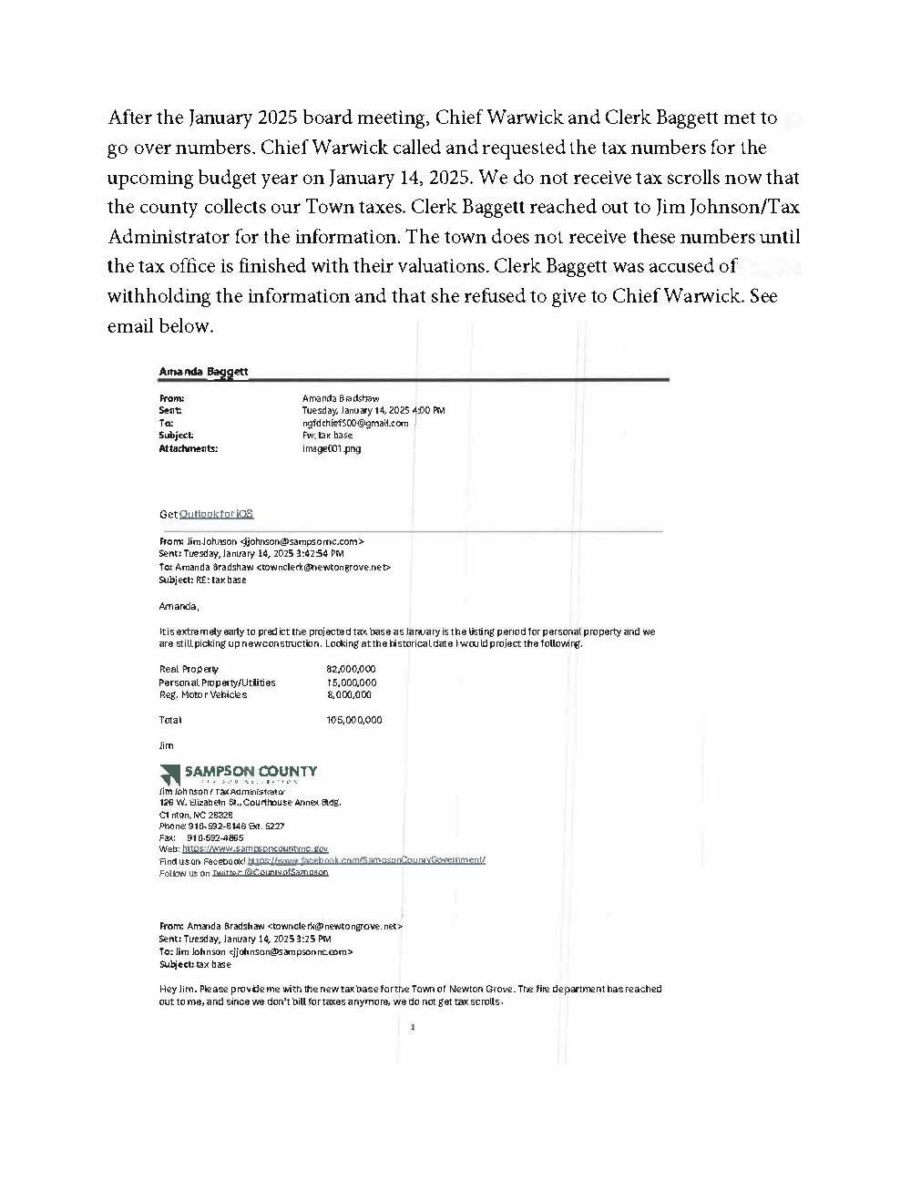

Slide 6
After sending the 1999 contract to legal, Attorney Lew Starling, Mayor Craig Warren, and Commissioner Chris Raynor spoke with Chief Warwick and informed him that there has never been a Town of Newton Grove Fire Tax.

Slide 7
It was mentioned in the 1999 contract, but was never legally put forth before Sampson County and the Town of Newton Grove’s board. Larry Britt informed us at a meeting held by the NGFD with their board, Mayor Warren, Commissioner Chris Raynor, Commissioner Bartely Warren, and Clerk Baggett that there never has been a fire tax in the Town of Newton Grove.

Slide 8
The next slide is a copy of the 1999 contract.

Slide 9
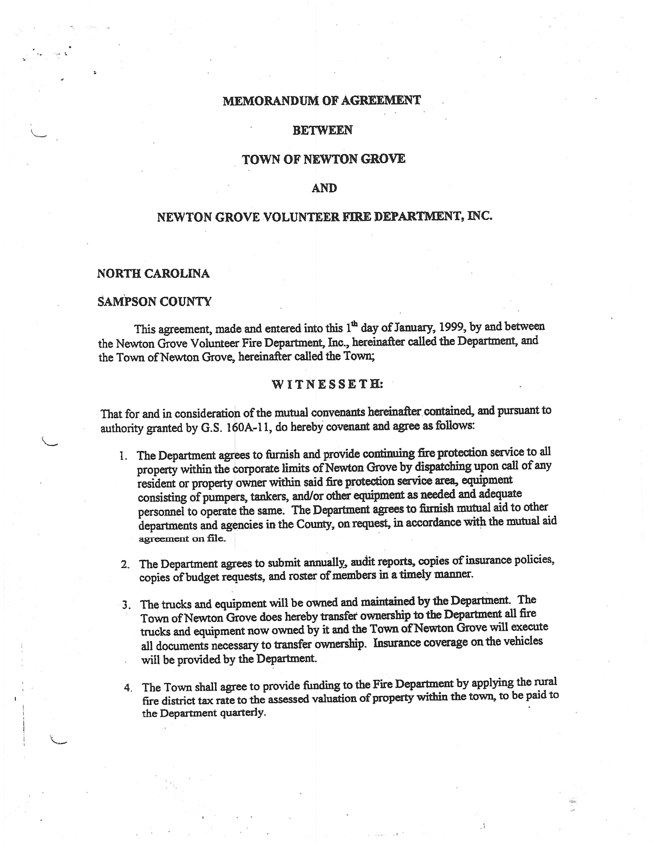
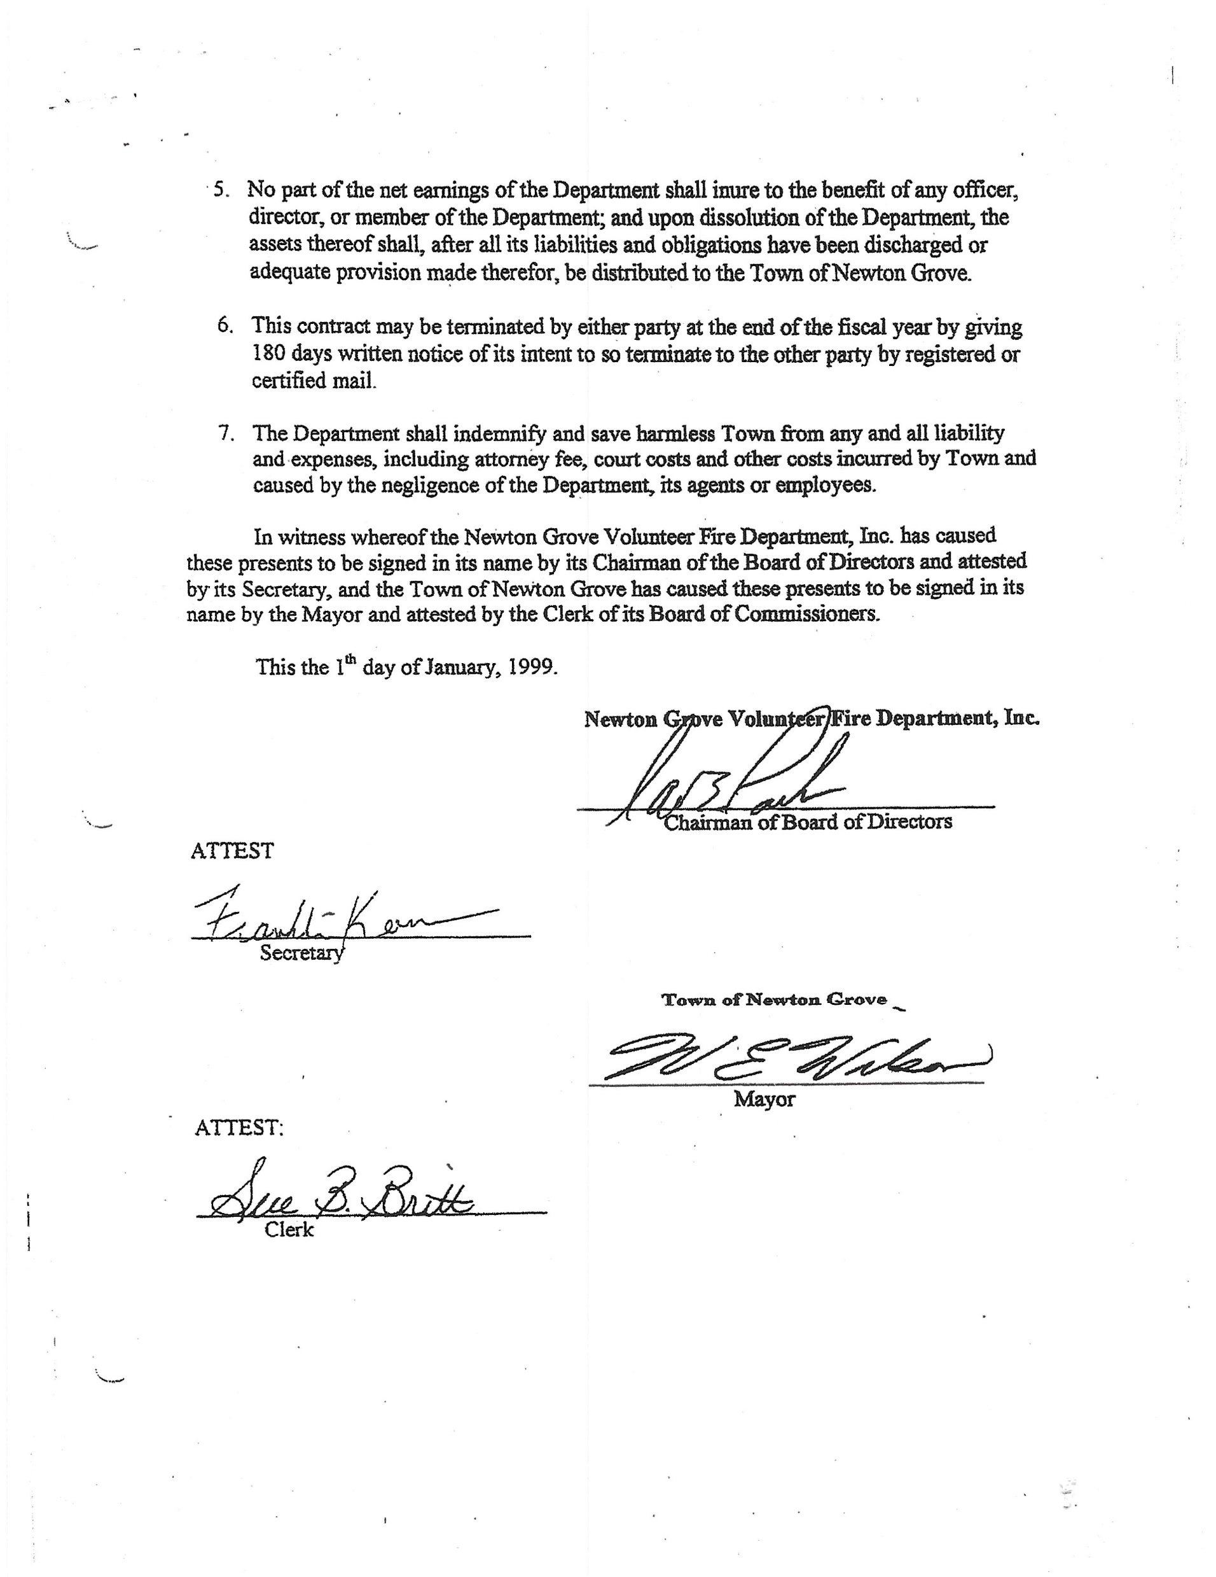

Slide 10
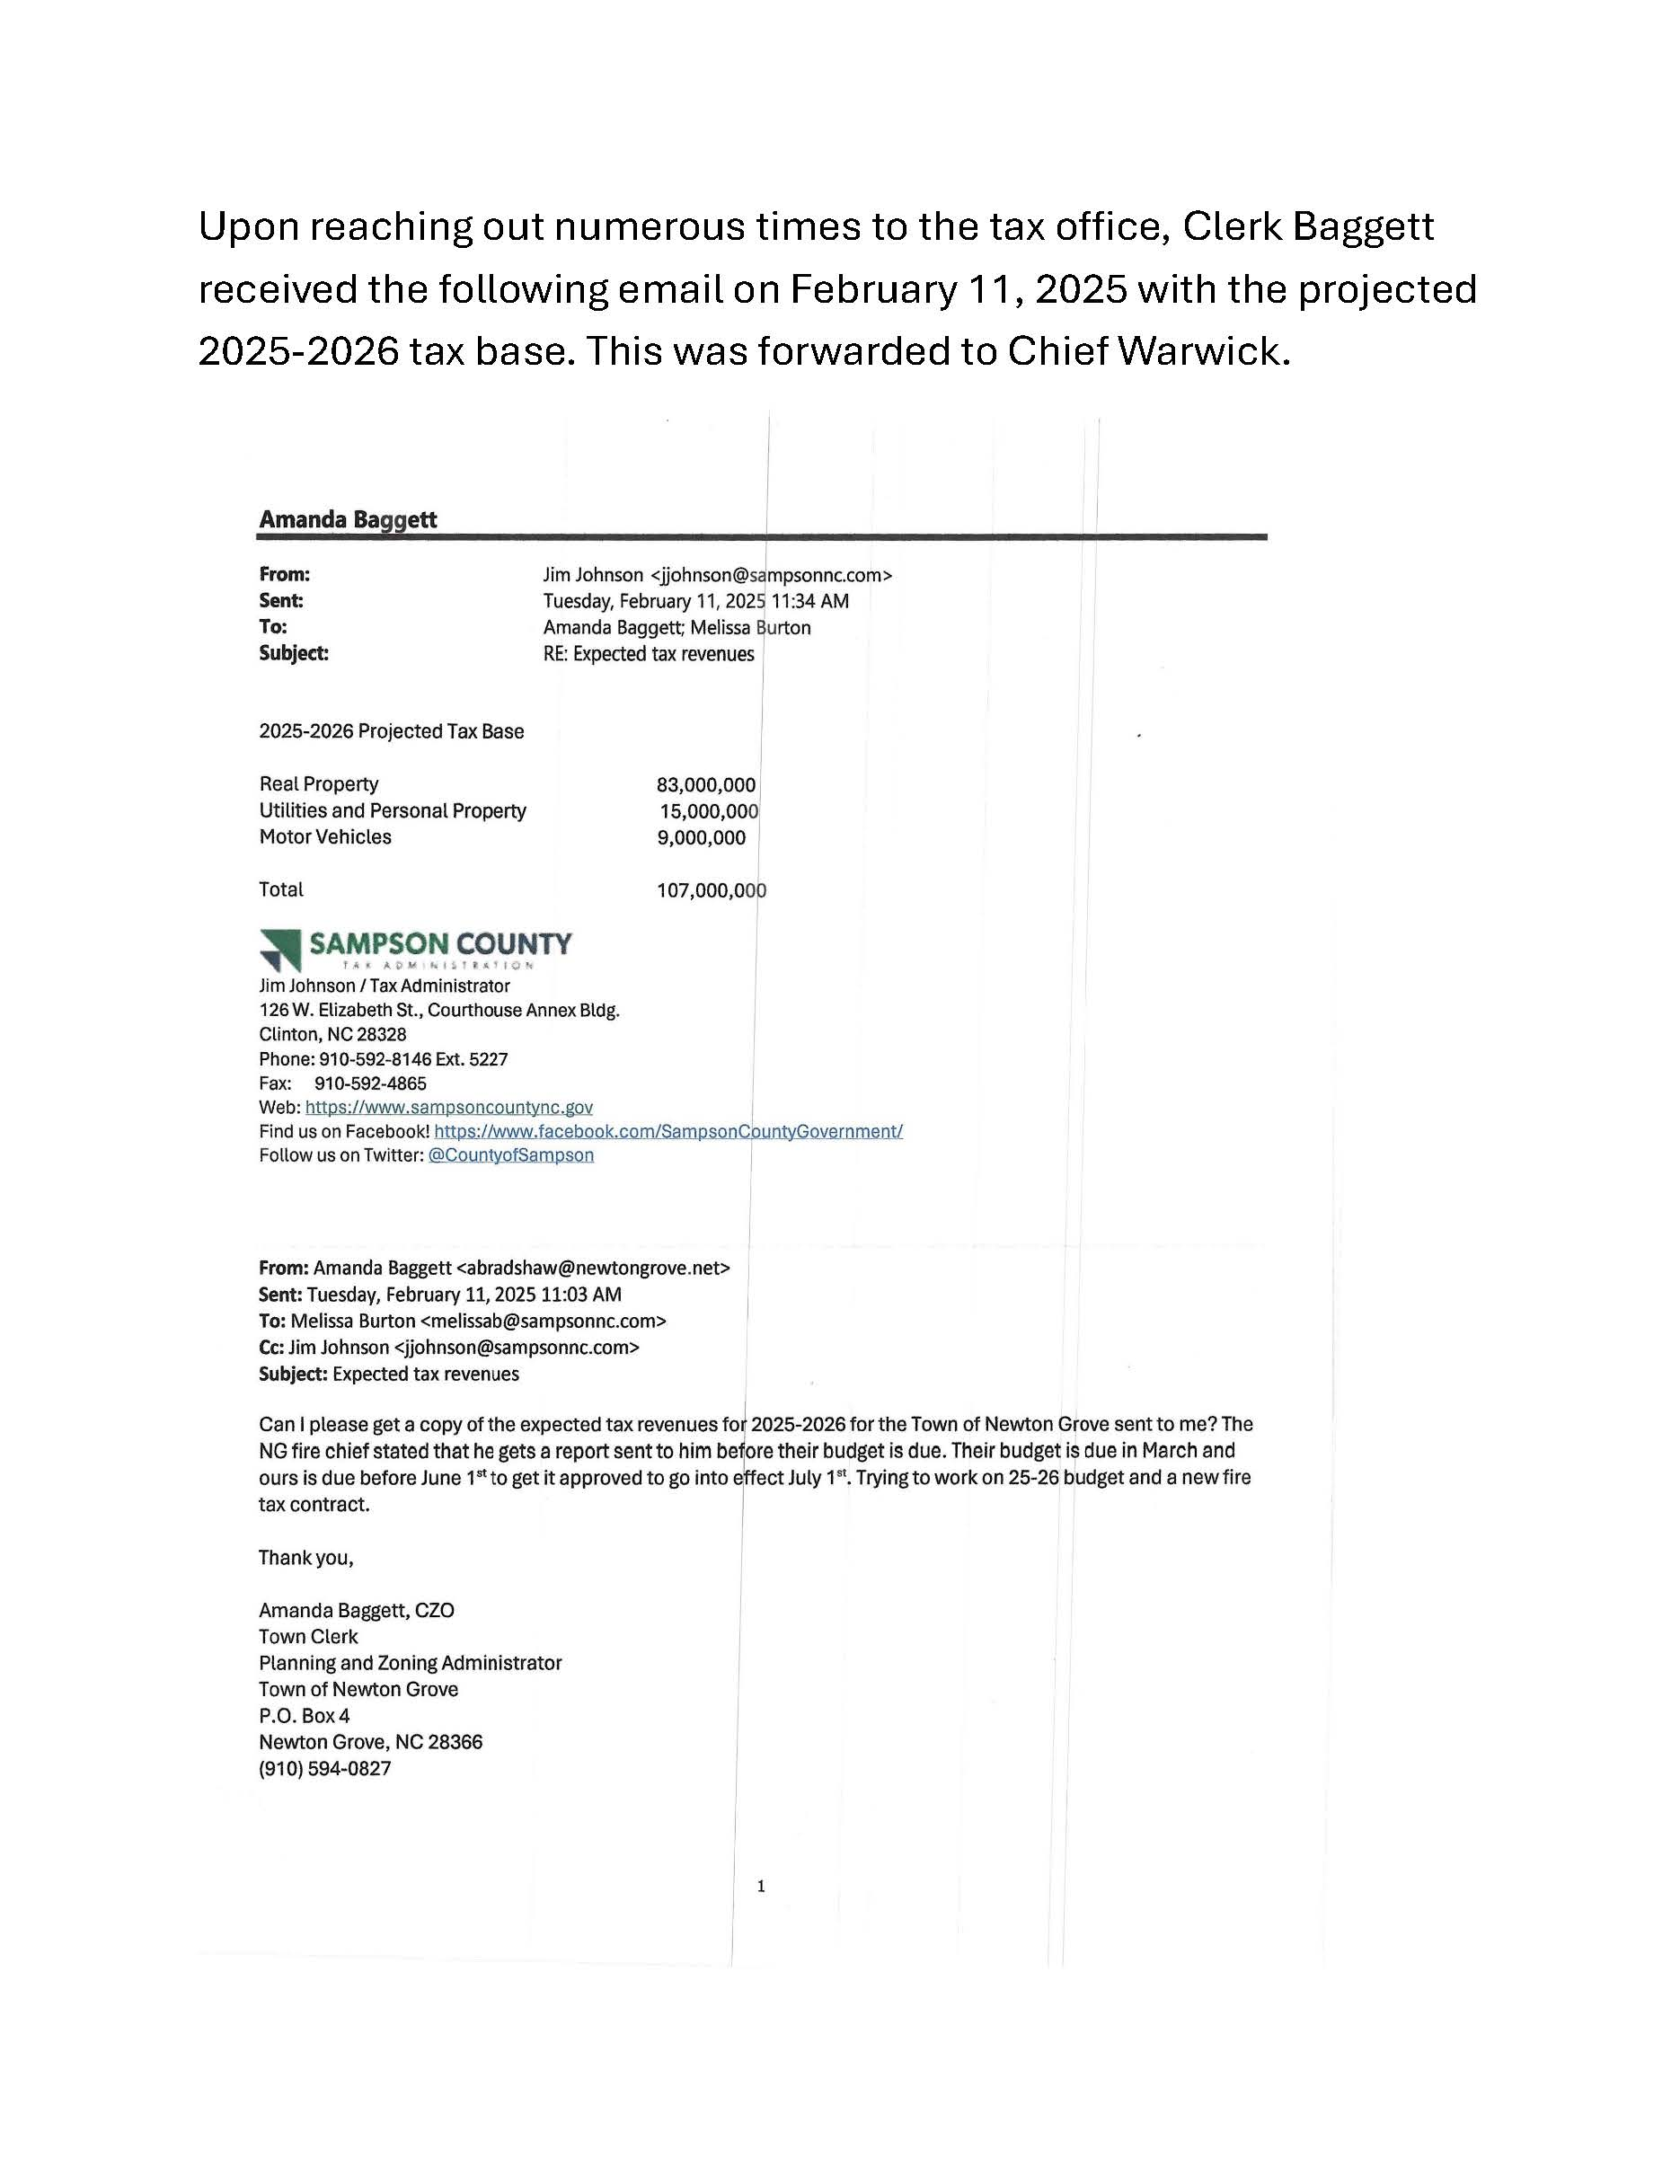

Slide 11
As of today, Sampson County collects a municipal fire tax for the following municipalities:
1. Autryville
2. Harrells
3. Turkey

Slide 12
As of today, the following municipalities that do not have a legal fire tax in place include the following and use the word “donation” in their budgets (this is not meant to be derogatory in any way and will be changed to a contracted service in the future budgets).
1. Garland (the town donates $20,000.00)
2. Salemburg (the town donates $25,000.00)
3. Newton Grove ($46,000.00)

Slide 13
The Town at some point did include a fire tax line in the budget message. Once discovered, it was removed. There is no statute that says you have to spend what you put in the budget. It is actually encouraged that you not spend your entire amount budgeted. A budget amendment is required only if you spend more than what was budgeted for.

Slide 14
The Fire Department was sent a certified letter informing them of the termination (at their request) of the 1999 contract. The Town was legally binded to give 180 days notice. The certified letter was signed for on 4/8/25. This means that the contract was still in effect until October 1, 2025.

Slide 15
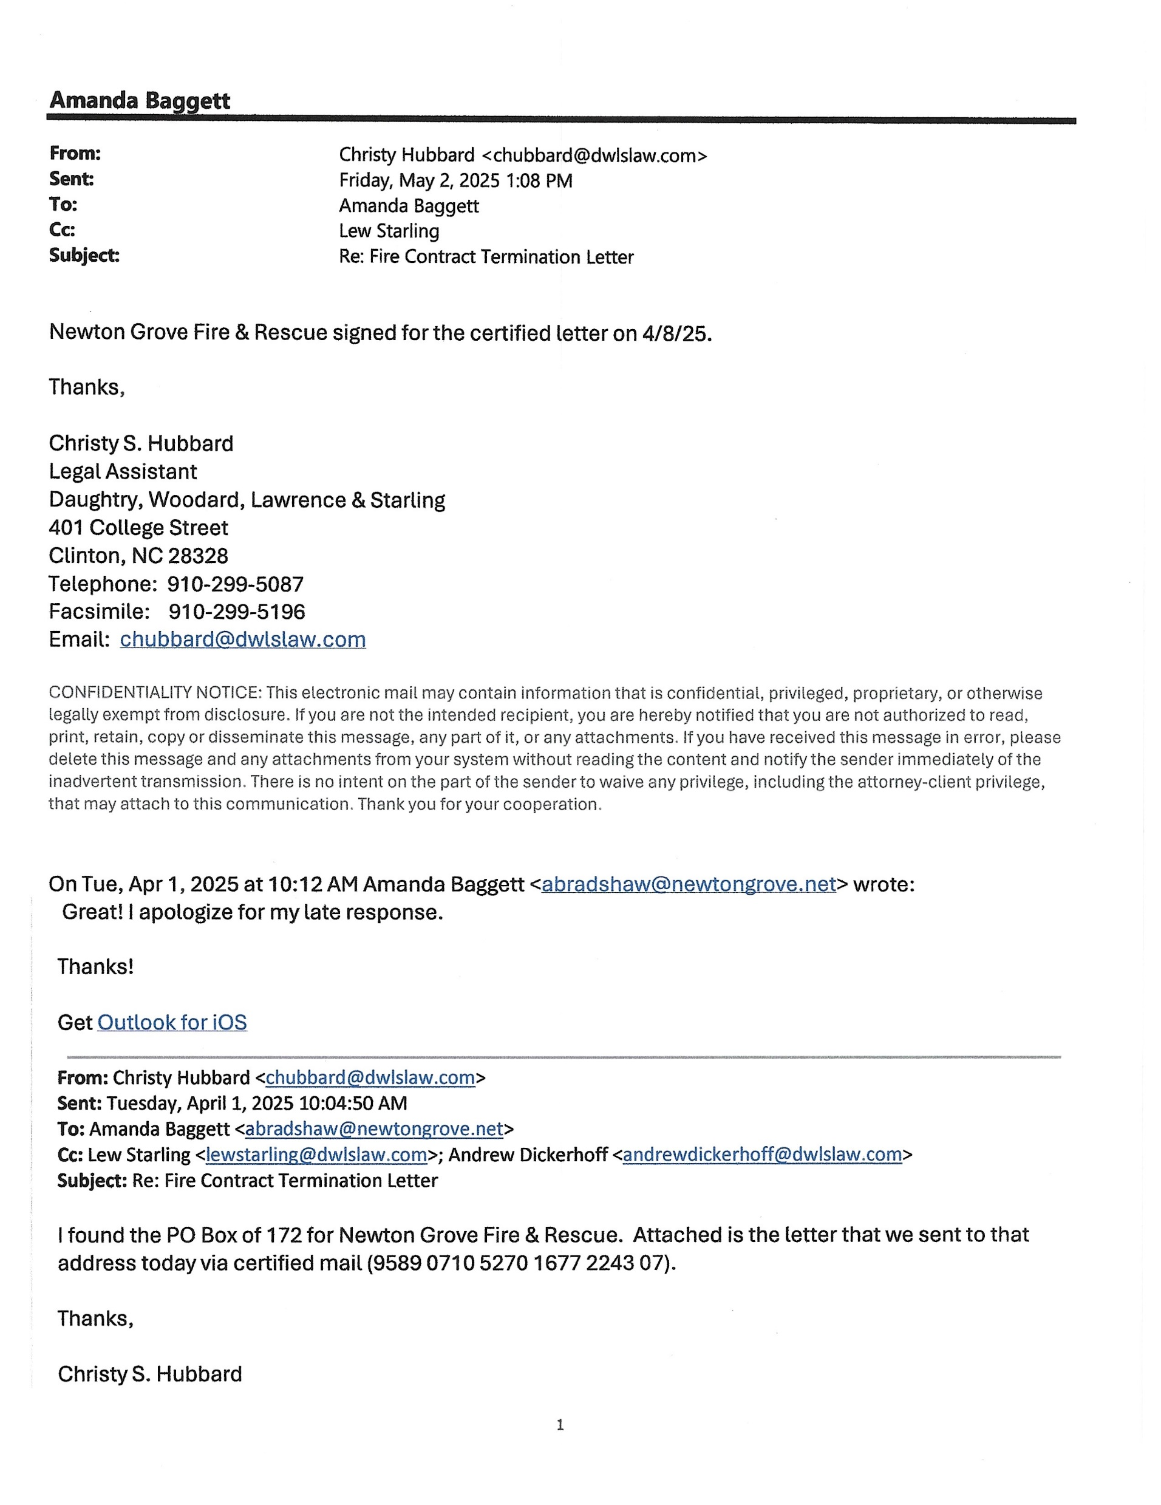

Slide 16
The Town of Newton Grove’s board approved a new contract on Monday, May 12, 2025. Mayor Warren handed a copy directly to Chief Warwick after the meeting.

Slide 17
Mayor Warren, Commissioner Chris Raynor, Commissioner Bartley Warren, and Clerk Baggett met with Chief Warren, and Fire Department board members Michael Warren, Greg Best, and Richie Warren on Wednesday, May 28, 2025 to discuss changes the Fire Department wanted to make.

Slide 18
In this meeting, they asked for certain verbiage on the exhibit page to be changed and the contract to go from 3 years to 1 year. Both sides discussed pursuing an actual Town fire tax in the correct way during the next fiscal year.

Slide 19
The Town sent the request to legal, and a new contract was made. The Town of Newton Grove’s Board approved the new contract Monday, June 9, 2025. In addition to the contract being approved, the Town of Newton Grove’s 2025-2026 budget was approved. A copy of the new contract was given to Chief Warwick right after the meeting.

Slide 20
June 24, 2025 Chief Warwick delivered a copy of the contract that he stated was the only one the Fire Department would approve. They requested that the entire exhibit page be taken out and the monetary payment be changed from $46,000.00 to $65,000.00.

Slide 21
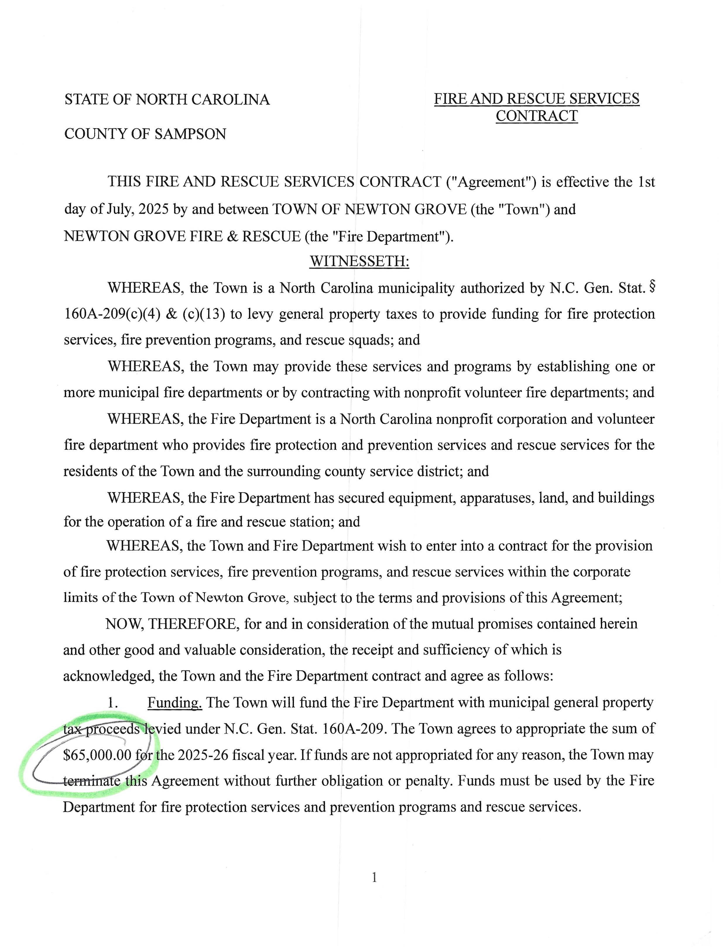
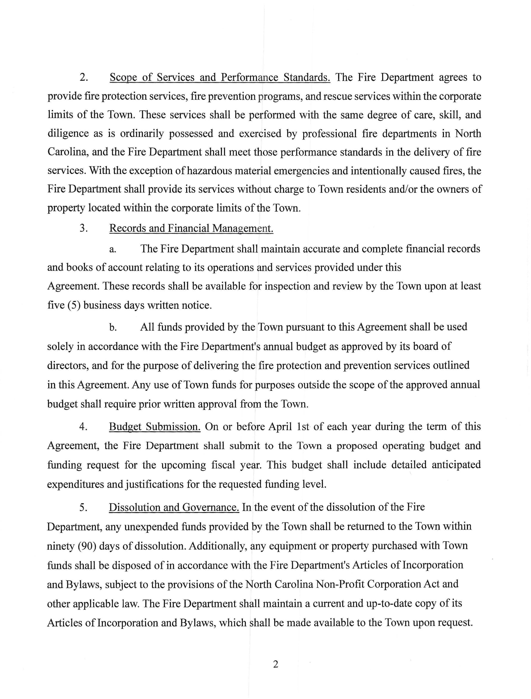

Slide 22
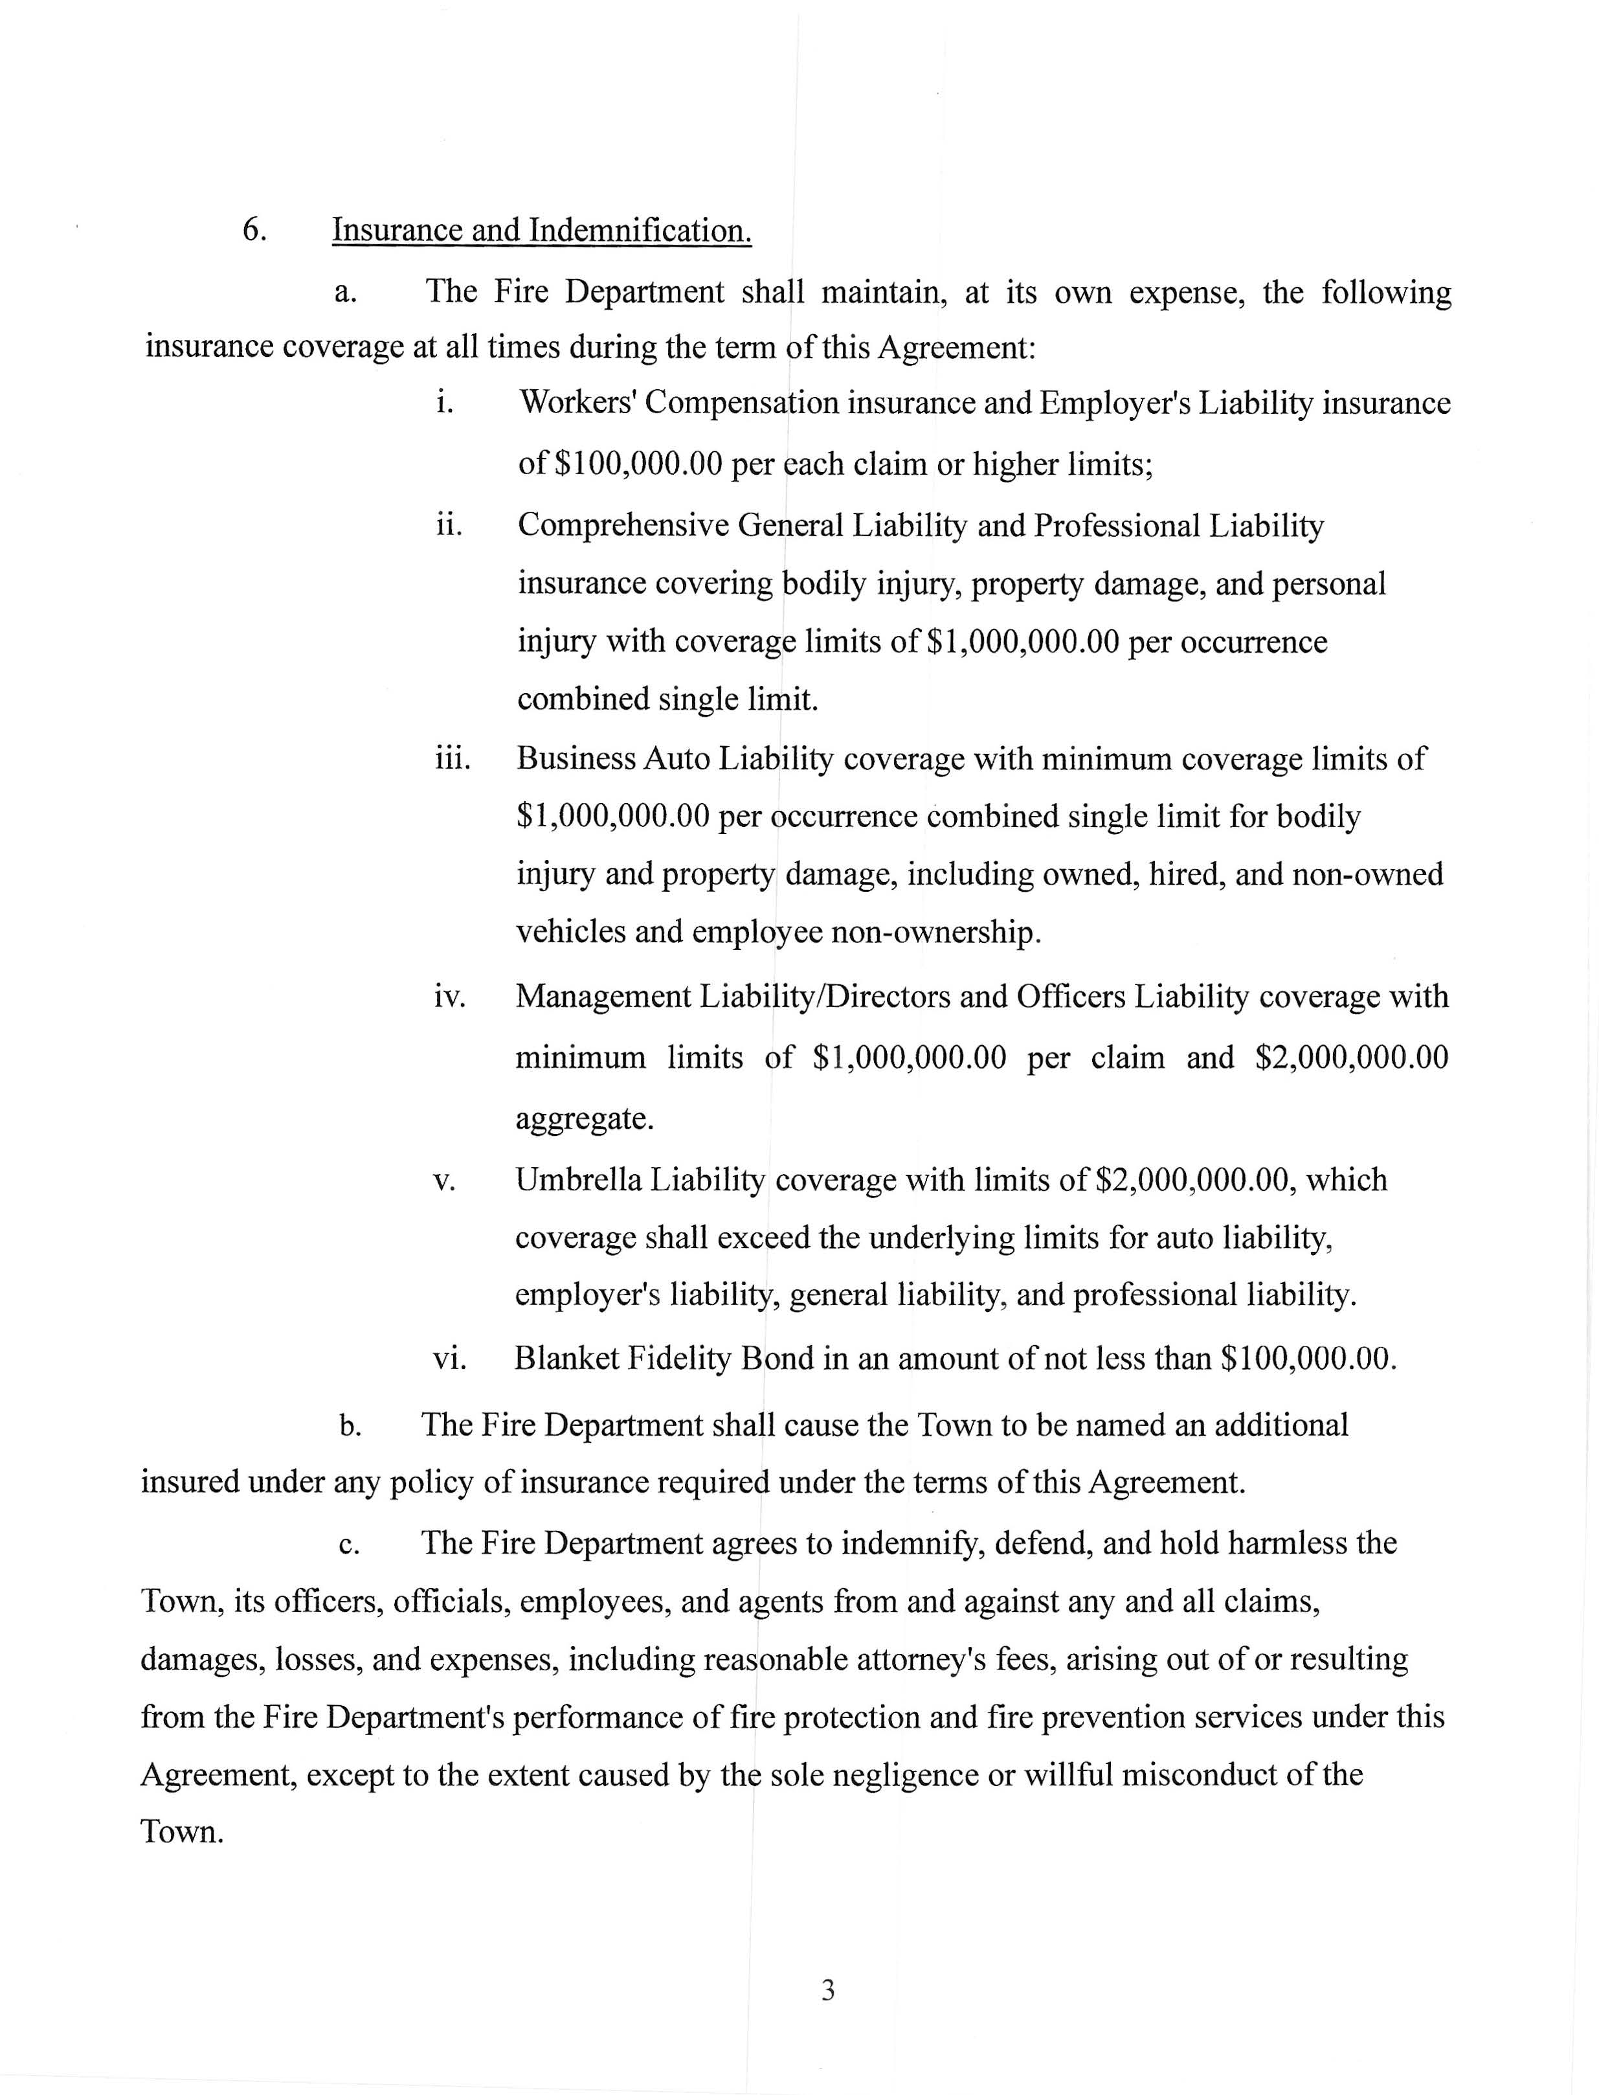
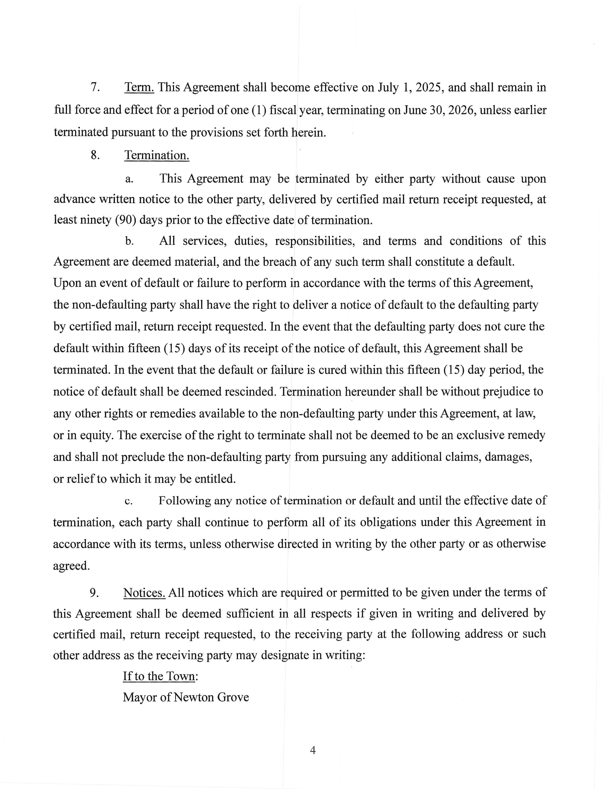

Slide 23
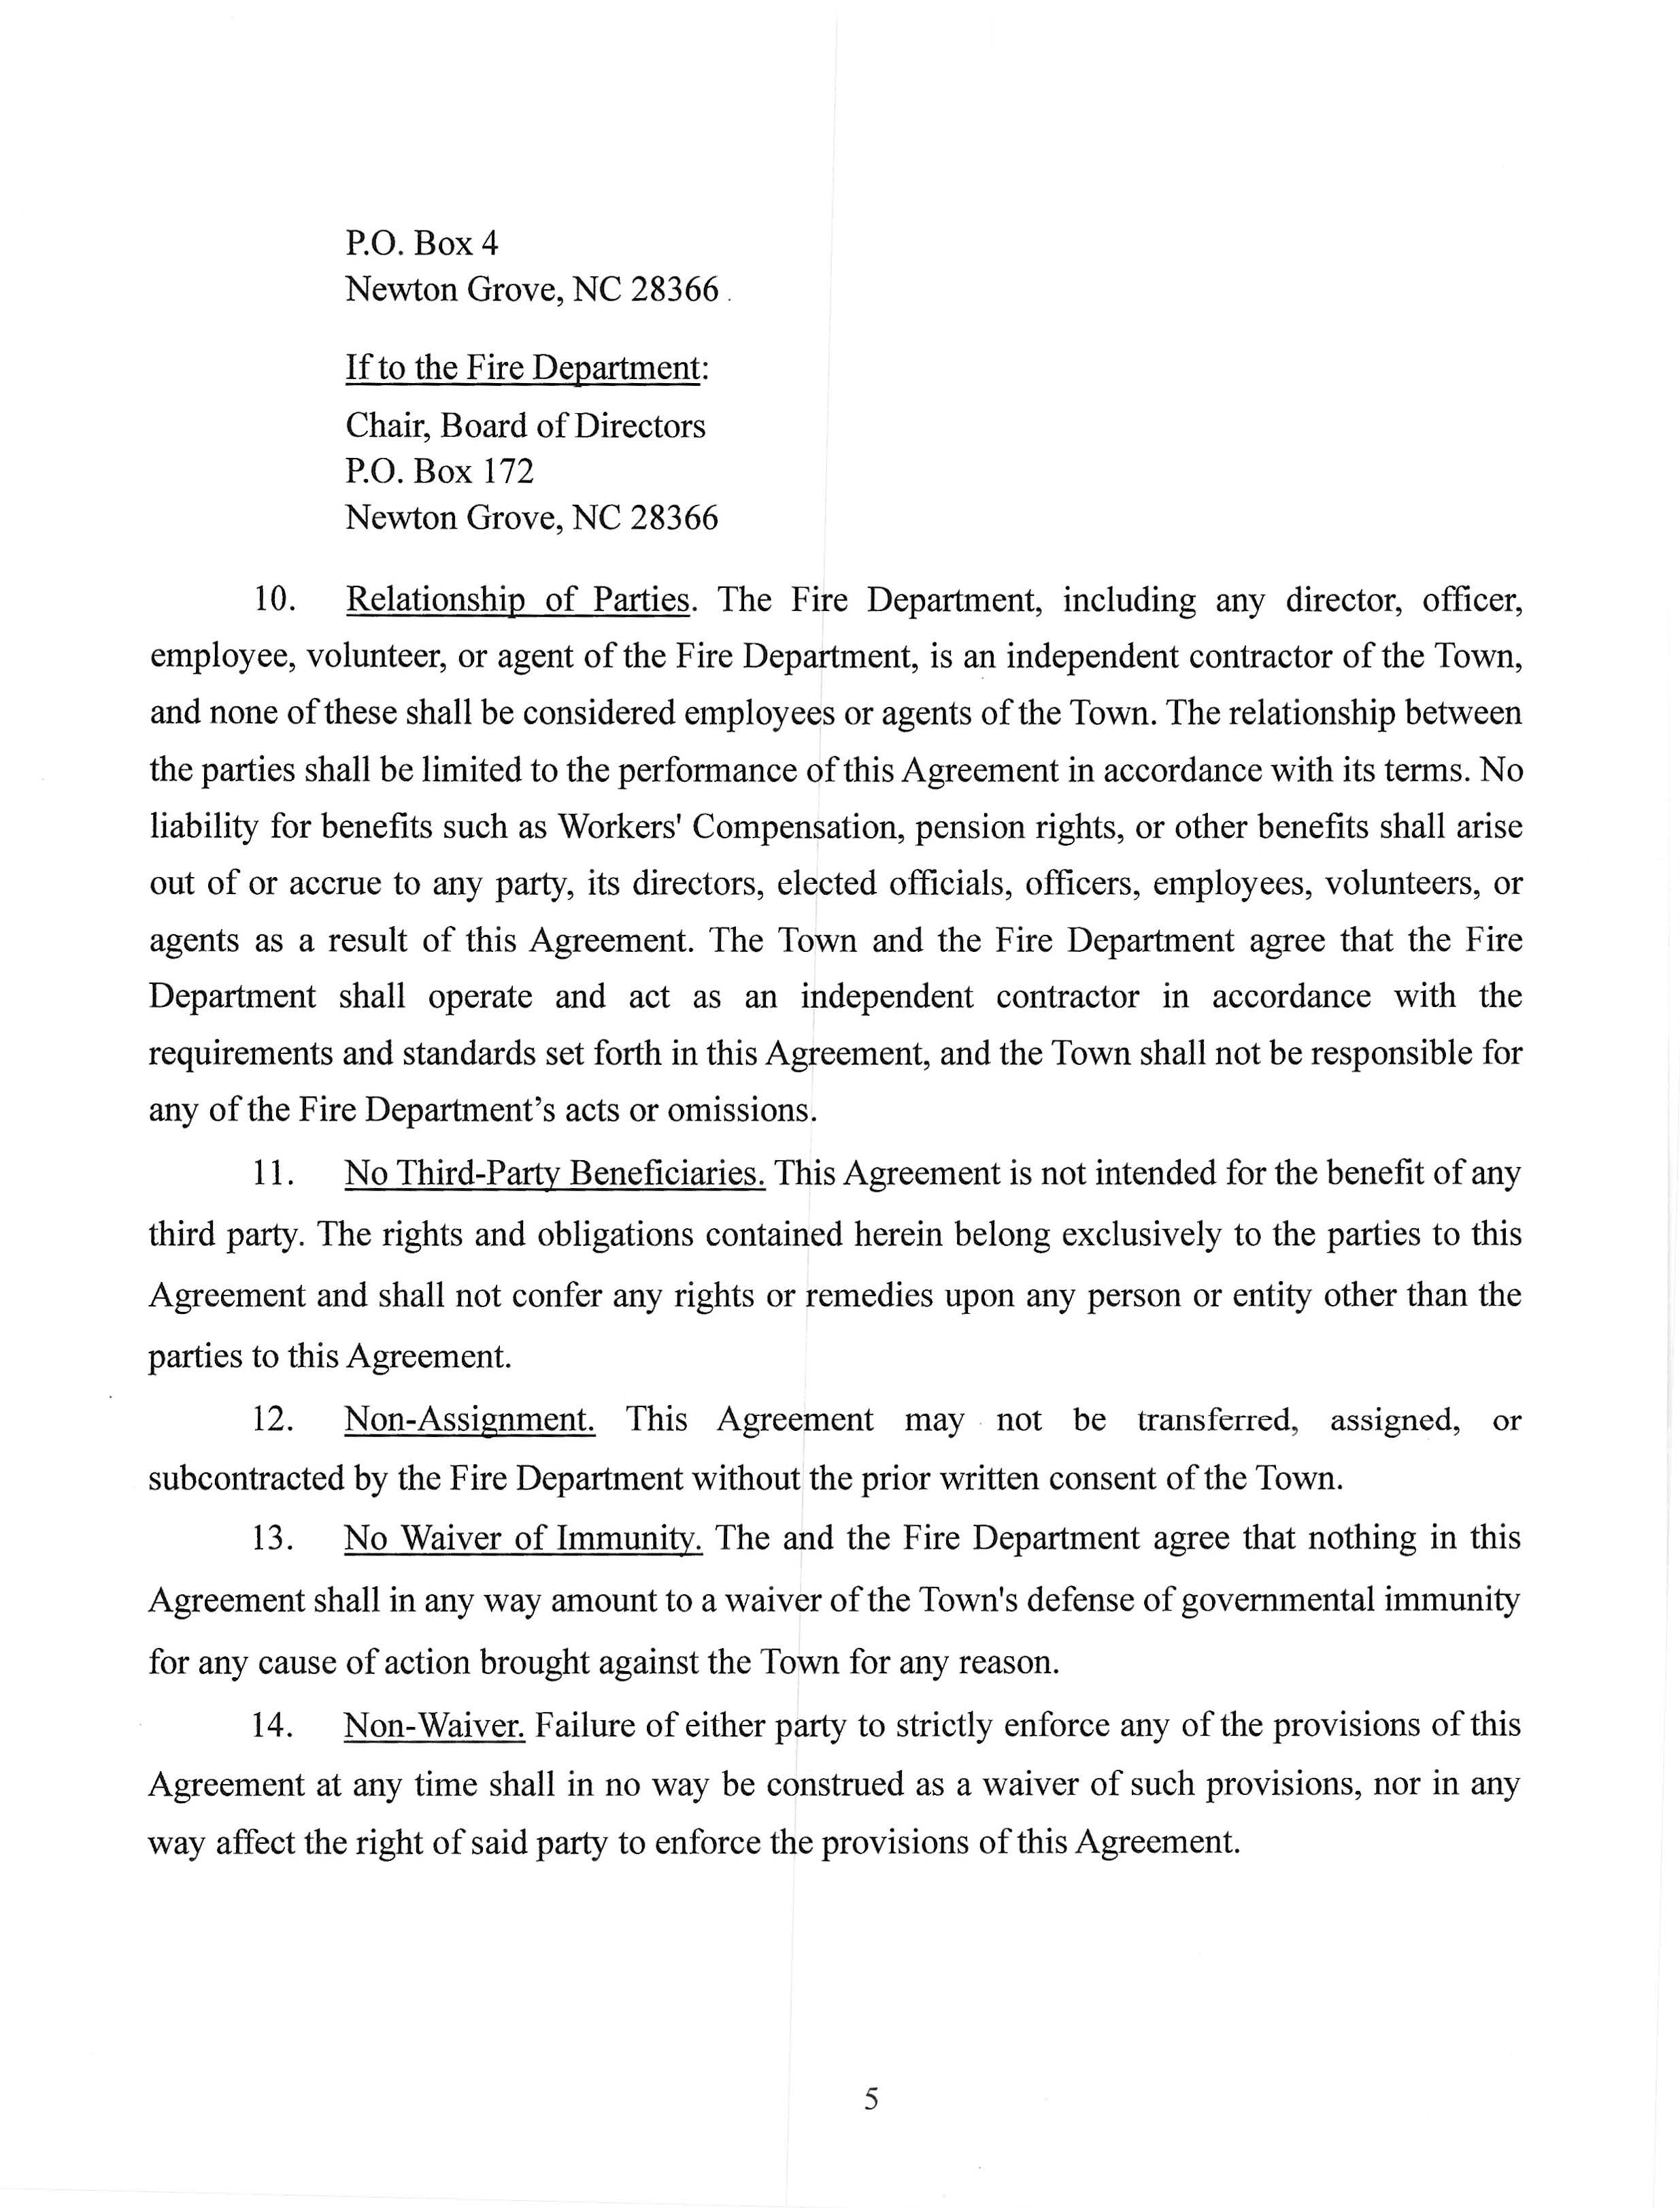
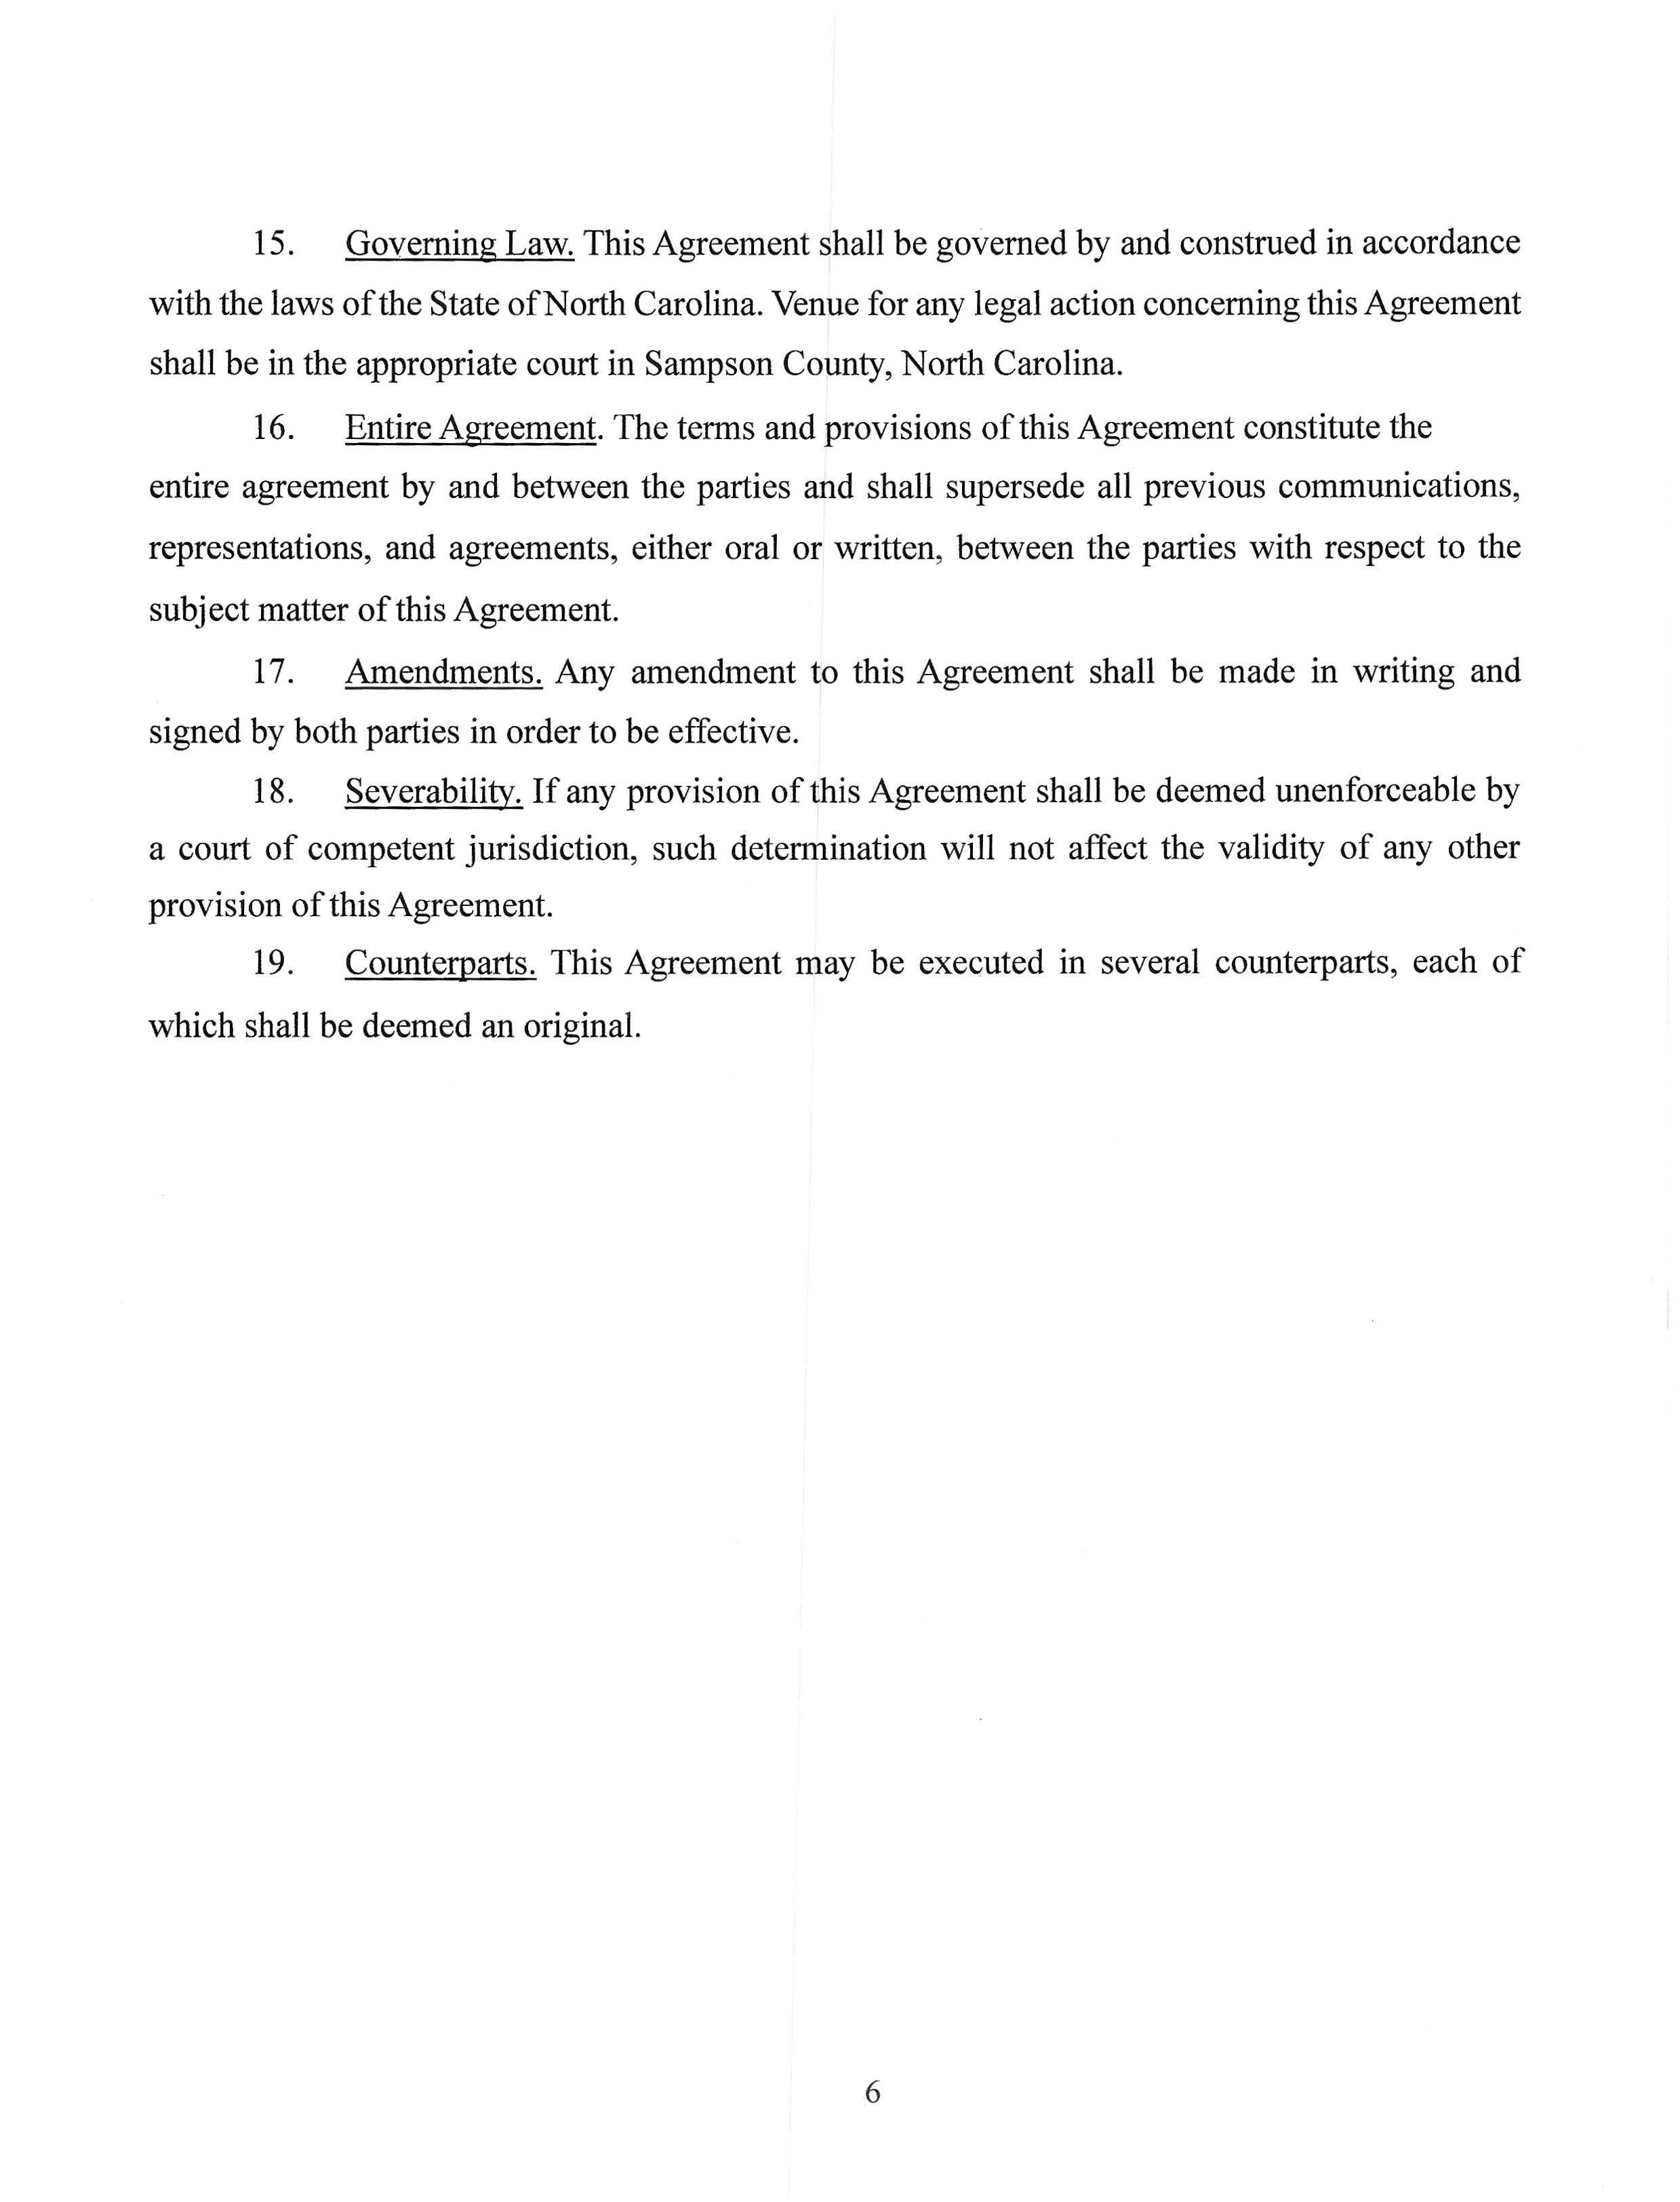

Slide 24
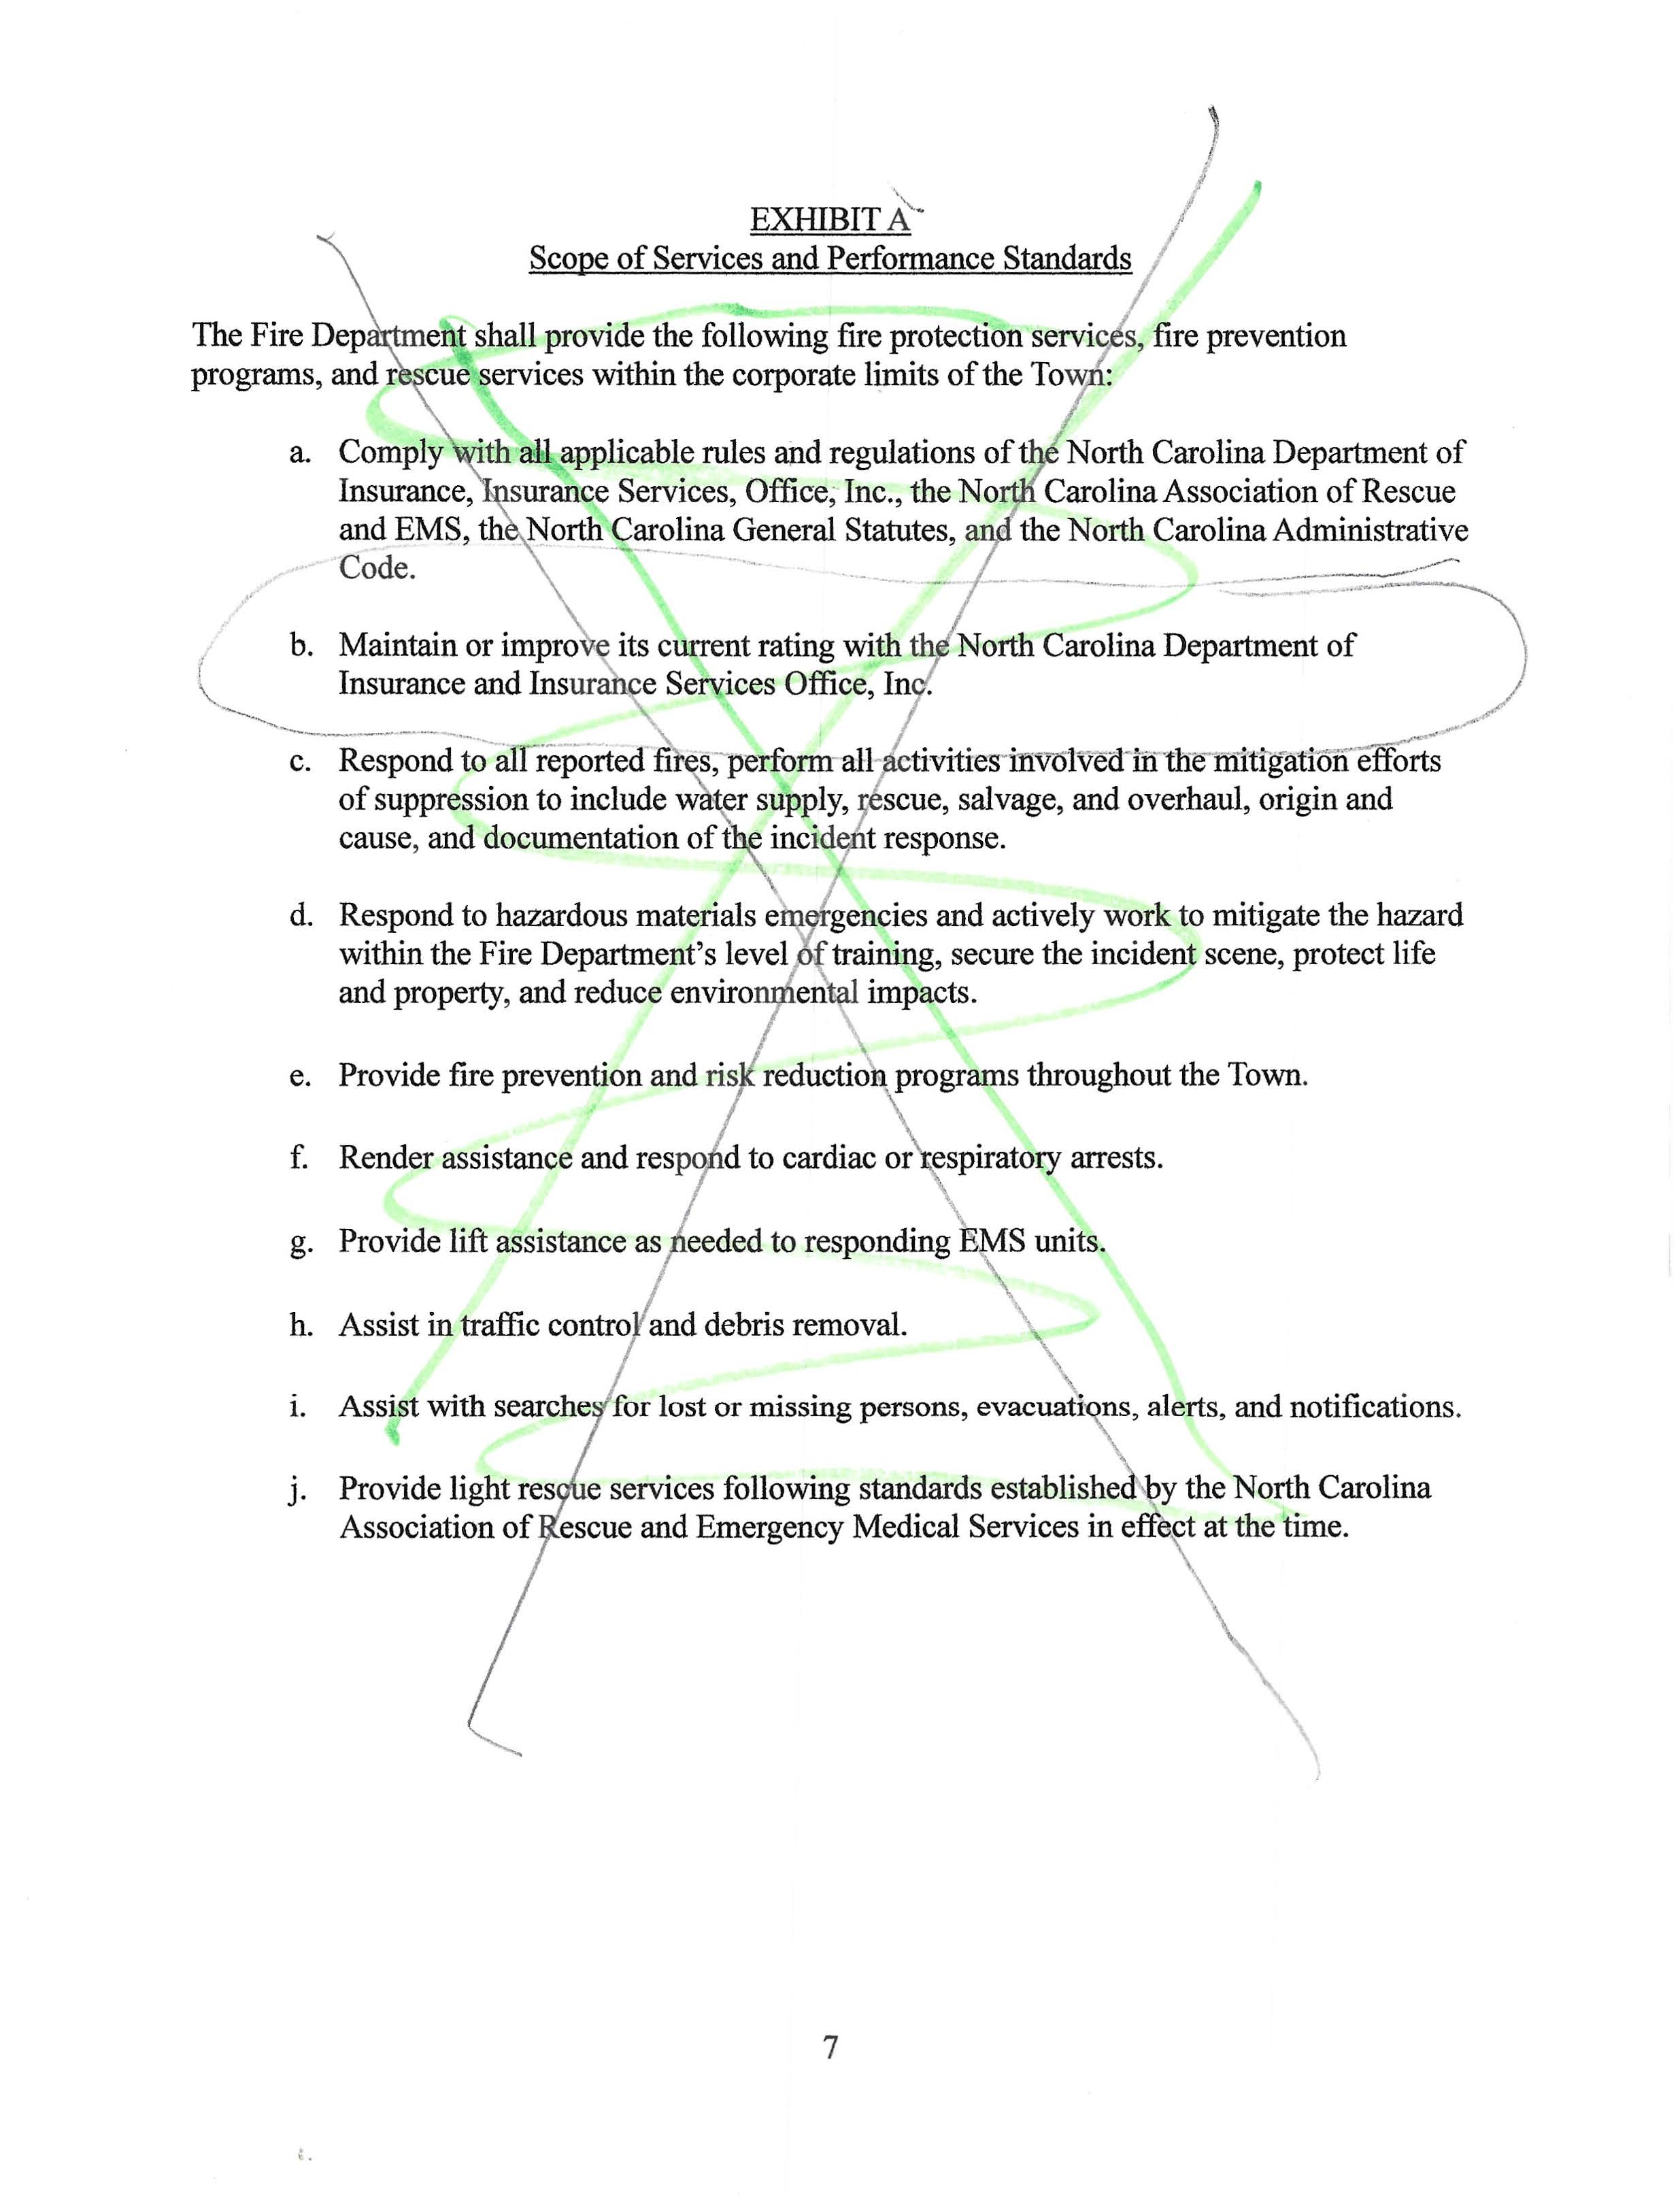
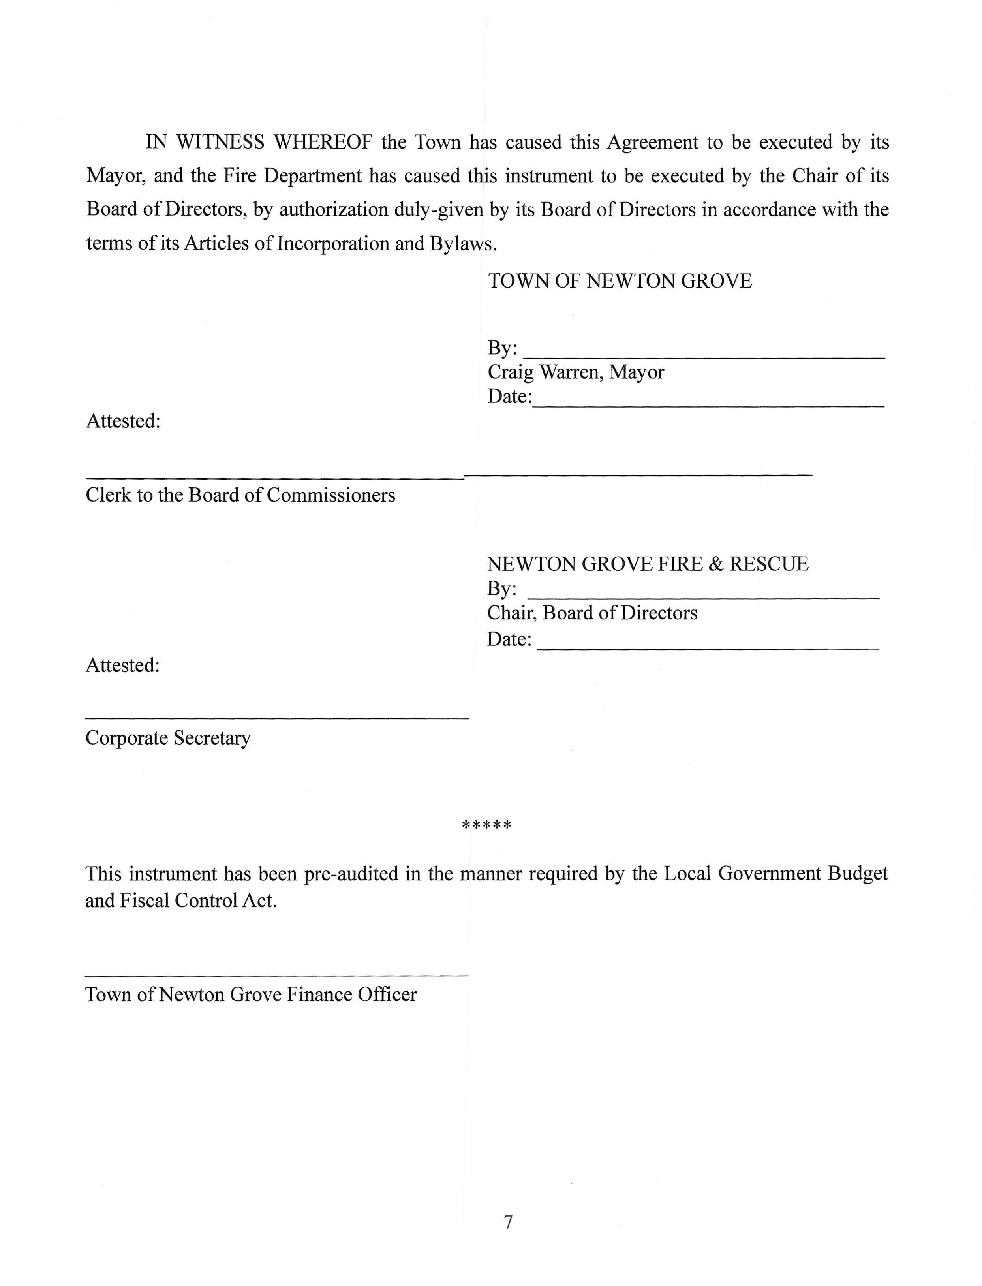

Slide 25
The Fire Department met Monday, June 16, 2025 and did not present the Town with the requested changes until June 24, 2025. The Town of Newton Grove’s 2025-2026 budget was approved on Monday, June 9, 2025.

Slide 26
The next two slides are the TR-2 report that is due every year on or before February 1st. It is completed by the Assistant Tax Administrator now that they collect the Town of Newton Grove’s taxes. The amounts circled are the taxable valuations for property and mvt.

Slide 27
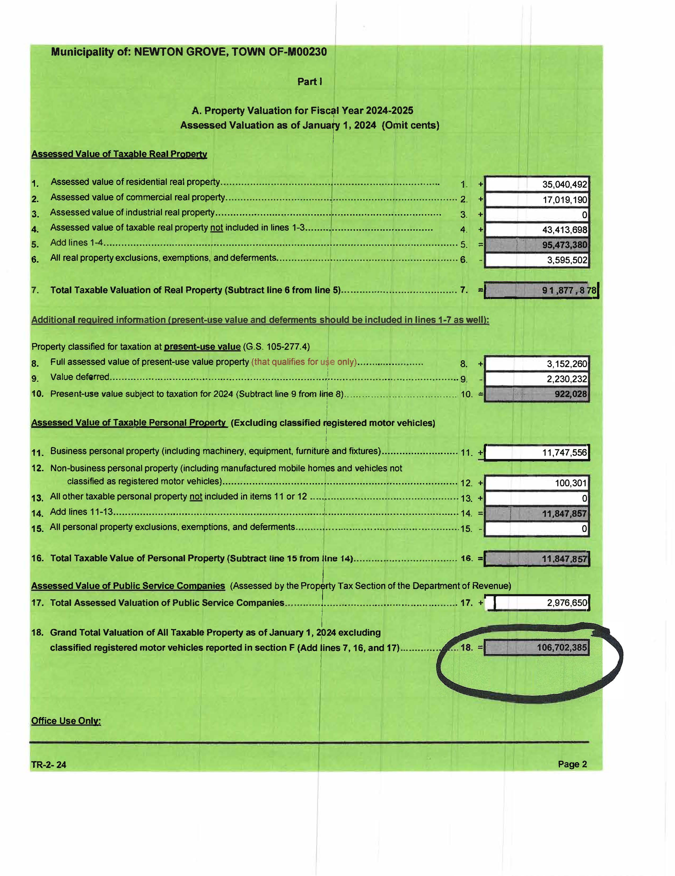

Slide 28
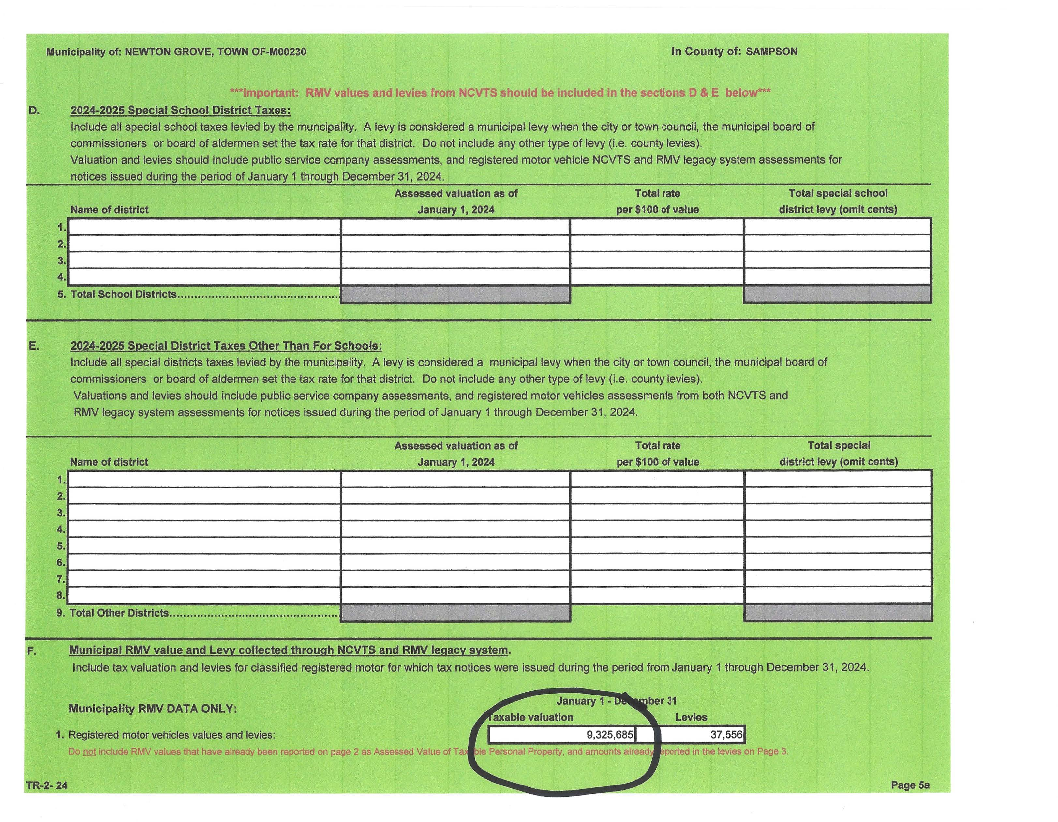

Slide 29
These are the steps taken to calculate tax revenue:
*The amount showed on TR-2 for property and MVT
*Divide that total by 100
*Multiply that by 0.40 (Town Tax Rate)
*Multiply that by 0.9862 (Town Collection Rate)
*Multiply that by 2% (County Collection Rate)
*Subtract that from total

Slide 30
116,028,070 ÷ 100 x 0.40 = 464,112.28
464,112.28 x 0.9862 = 457,707.53
457,707.53 x 2% = 9,154.15
457,707.53 – 9,154.15 = 448,553.38

Slide 31
Based on the tax revenue received by the Town as of 5/12/2025, Clerk Baggett budgeted for:
Property Tax Revenue: $360,000.00
MVT Revenue: $28,000.00
Total budgeted Tax Revenue: $388,000.00

Slide 32
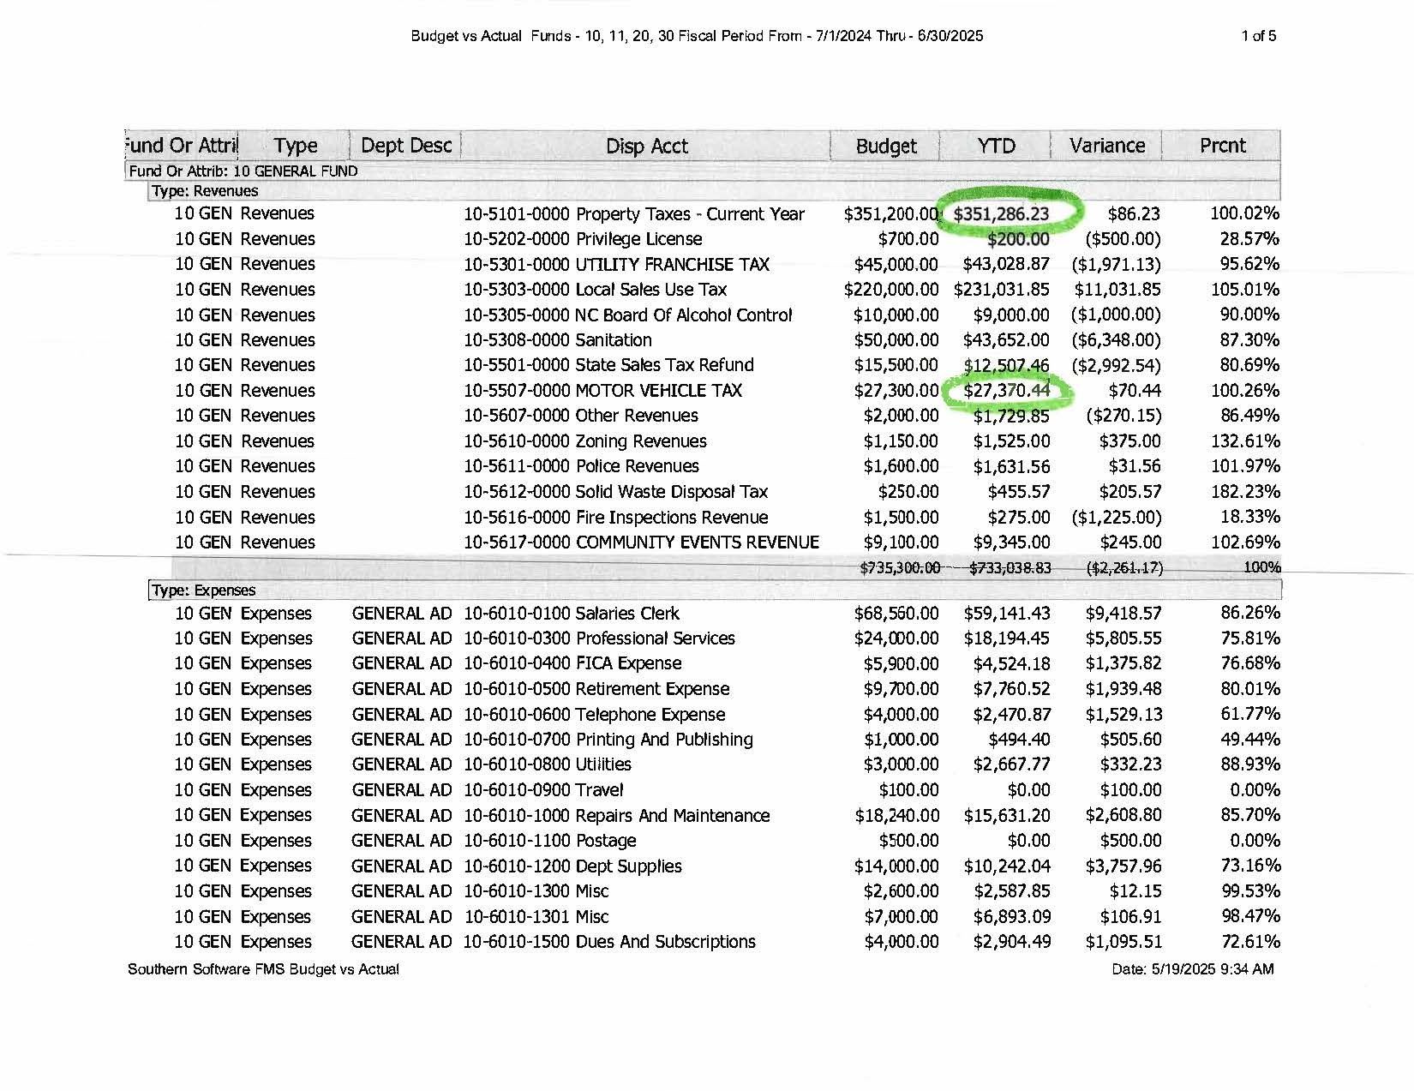

Slide 33
The 2025-2026 budget was presented to the Town of Newton Grove Board at their May 12, 2025 meeting. They approved the proposed budget to be presented to the public at the June board meeting and to be published in the newspaper.

Slide 34
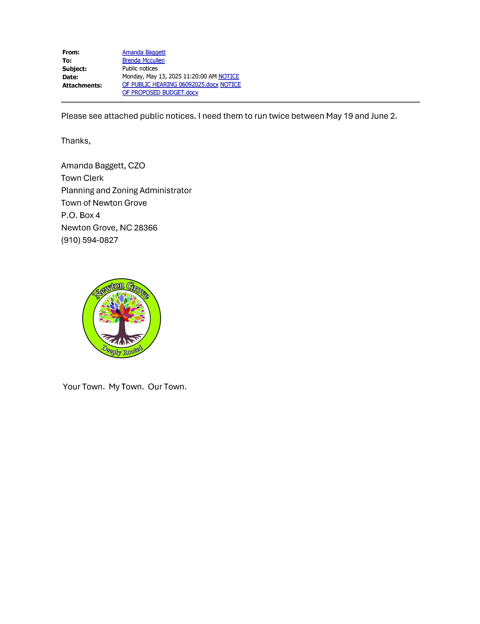

Slide 35
Once the proposed budget is put out for public notice, it cannot be changed. It was published on our website, copies were available at Town Hall, and was published in the newspaper on May 21st and May 28th of 2025.

Slide 36
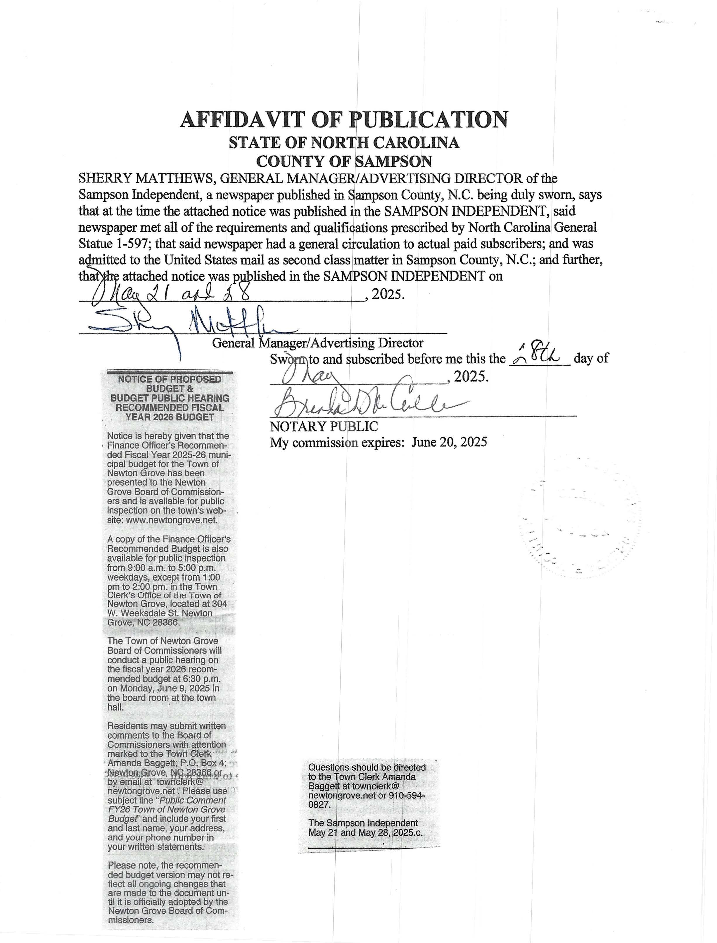

Slide 37
On Thursday, May 22, 2025 Clerk Baggett received an email with April 2025 tax distribution. This was after the budget had already been proposed and put out for public notice.

Slide 38
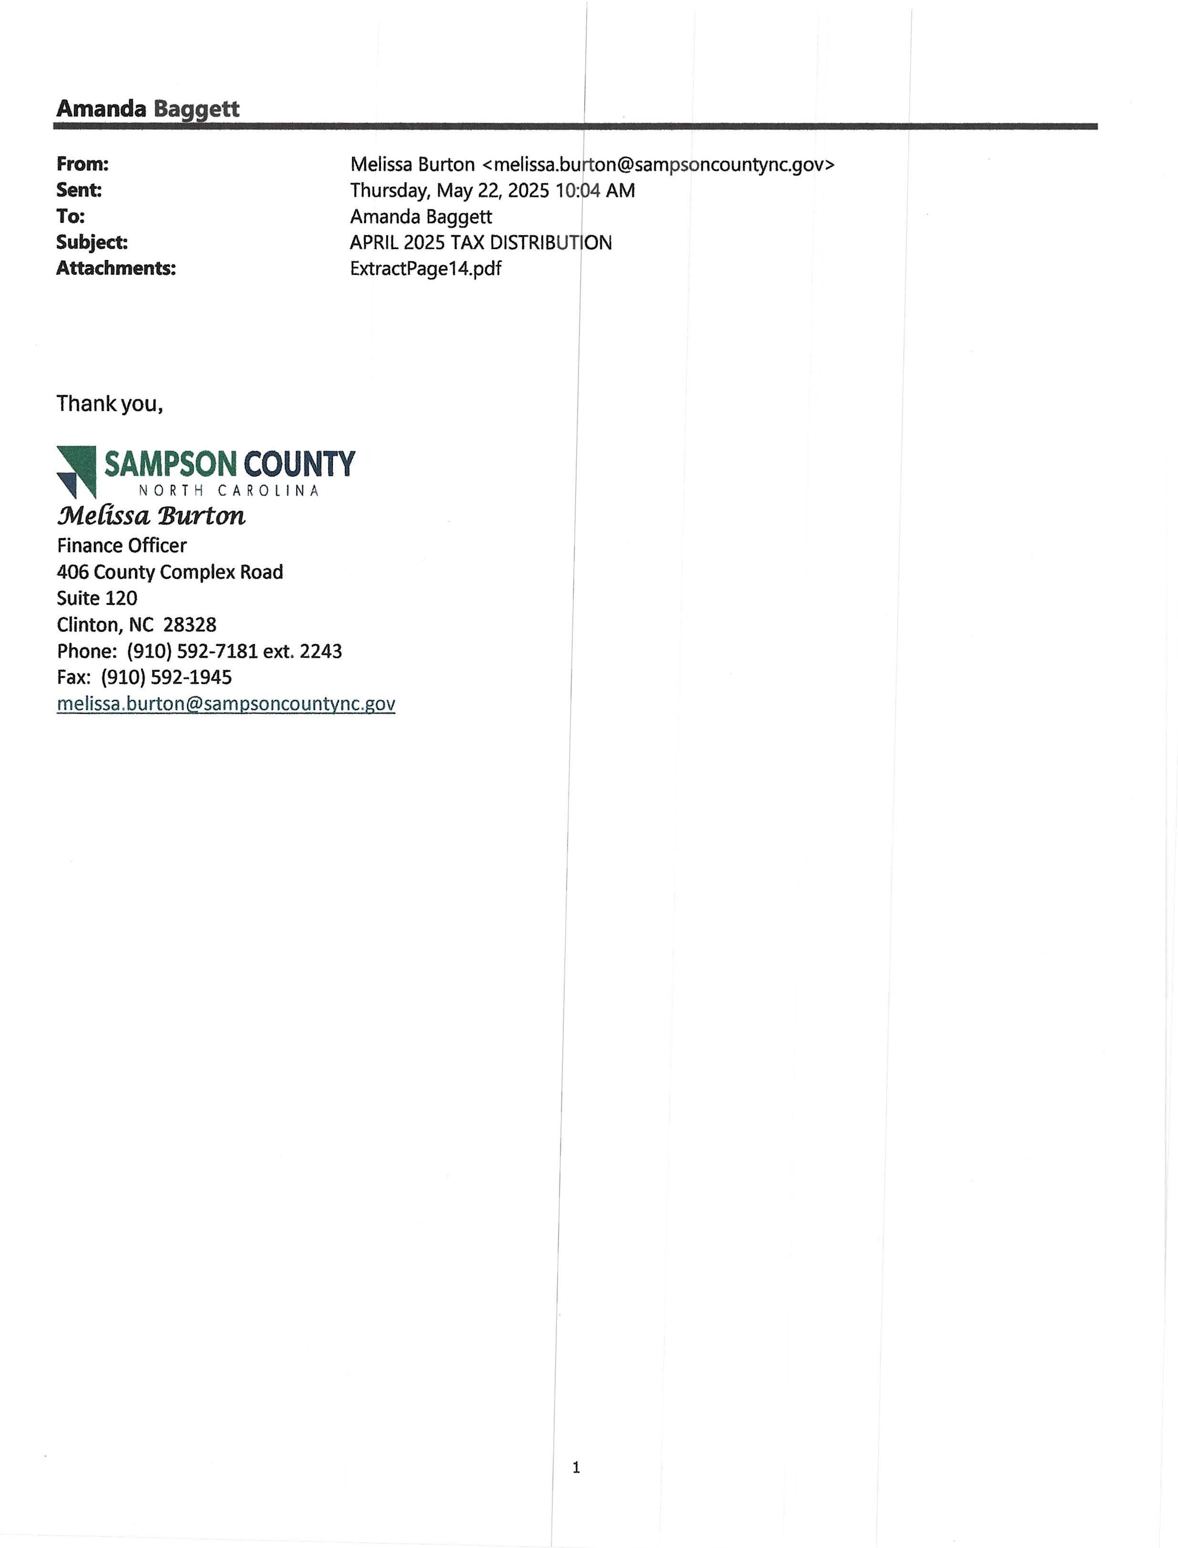

Slide 39
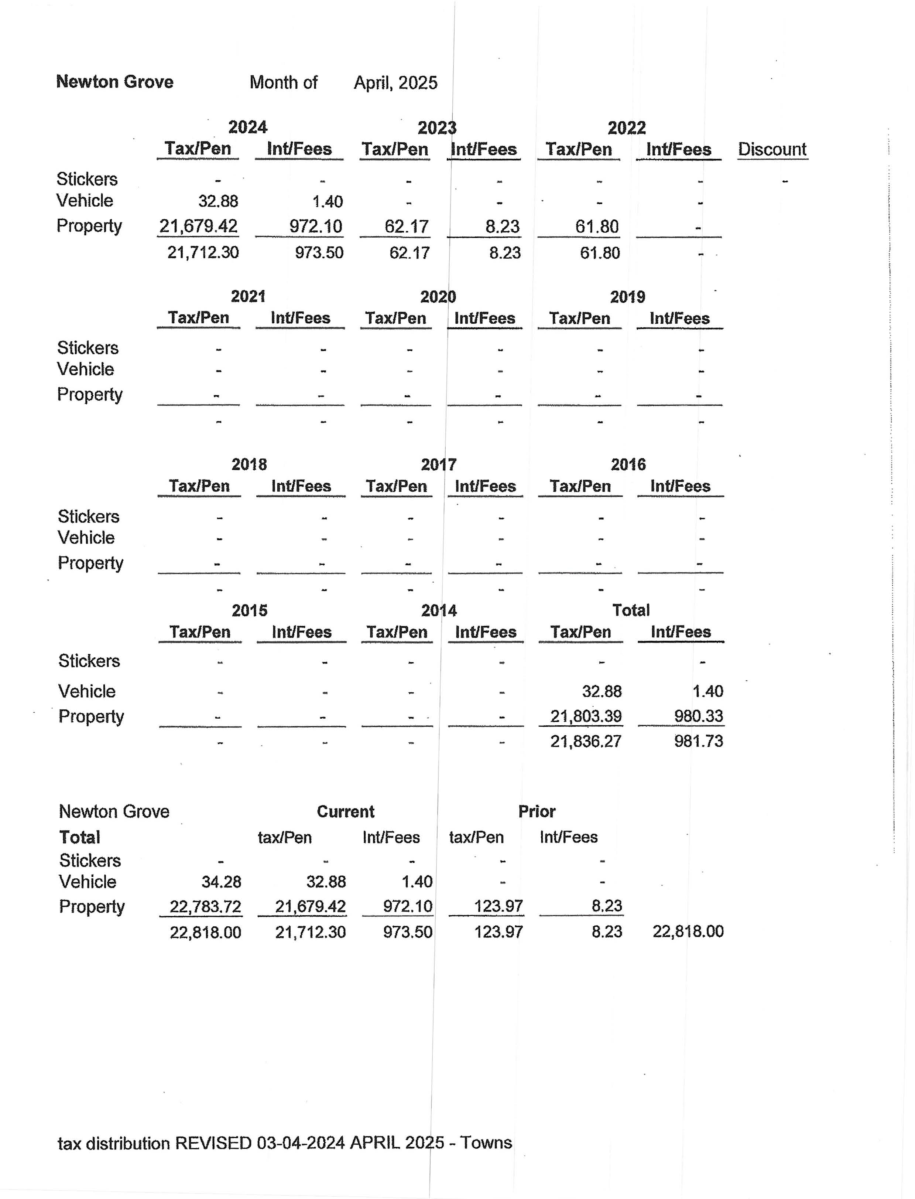
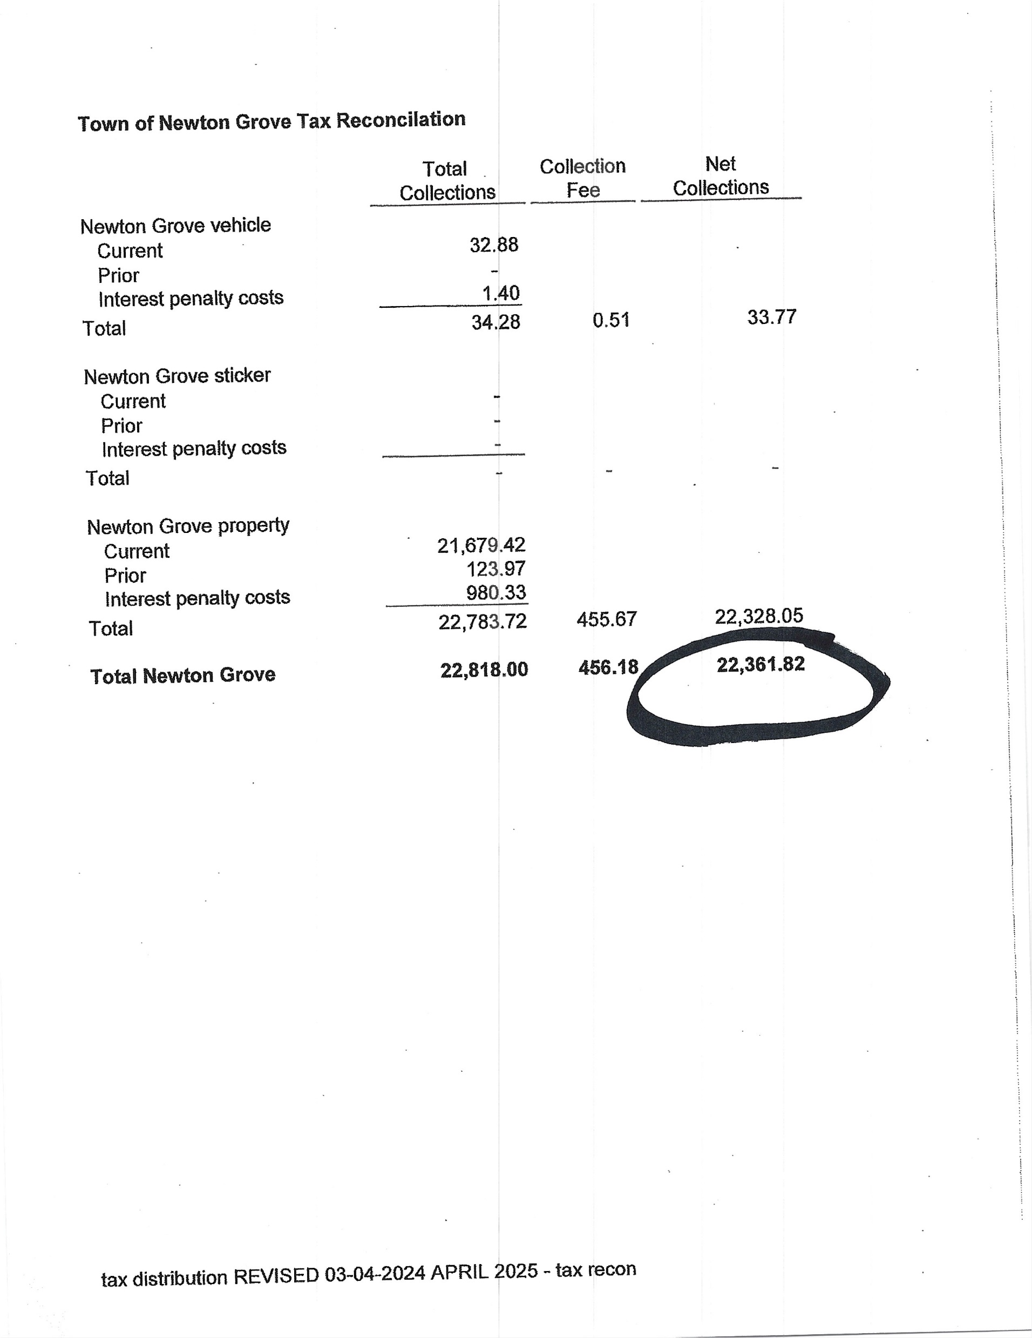

Slide 40
The next slide shows the ending balance for both Property Tax and MVT for Fiscal Year 2024-2025.

Slide 41
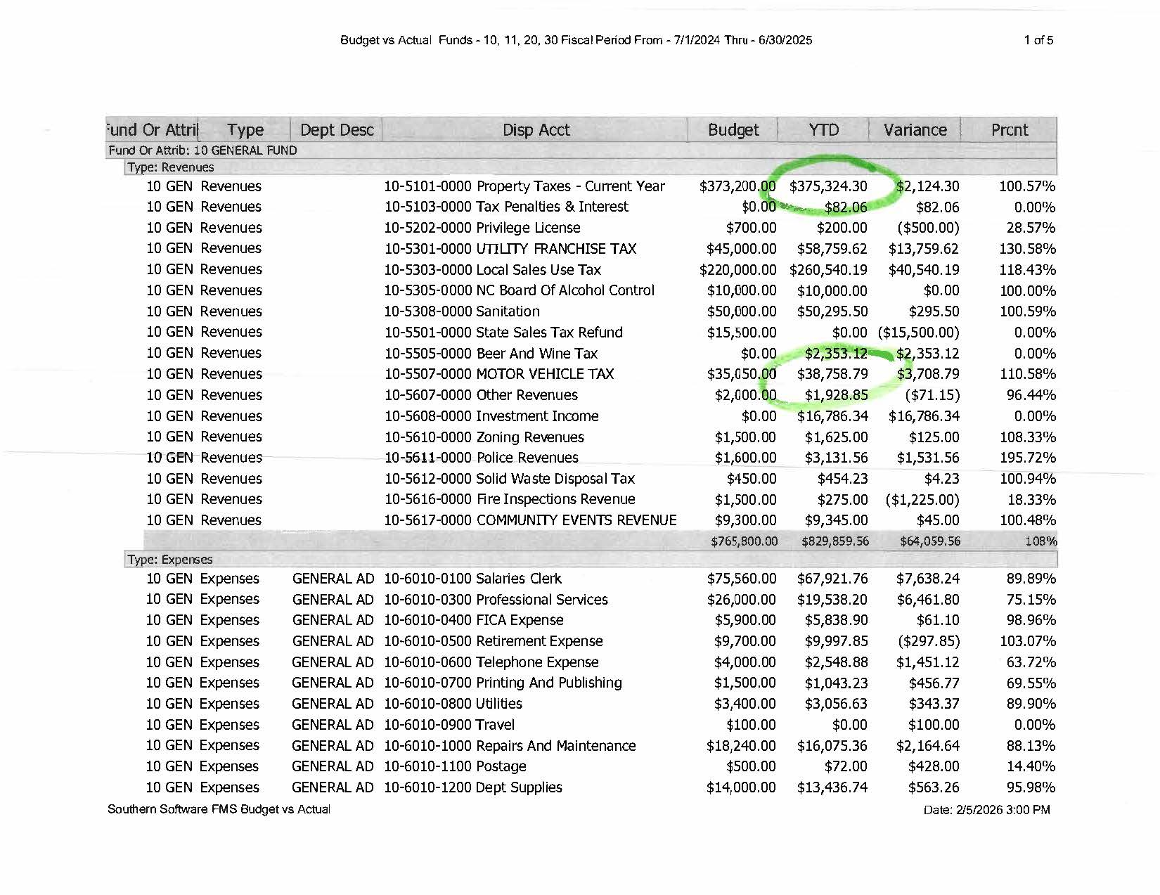

Slide 42
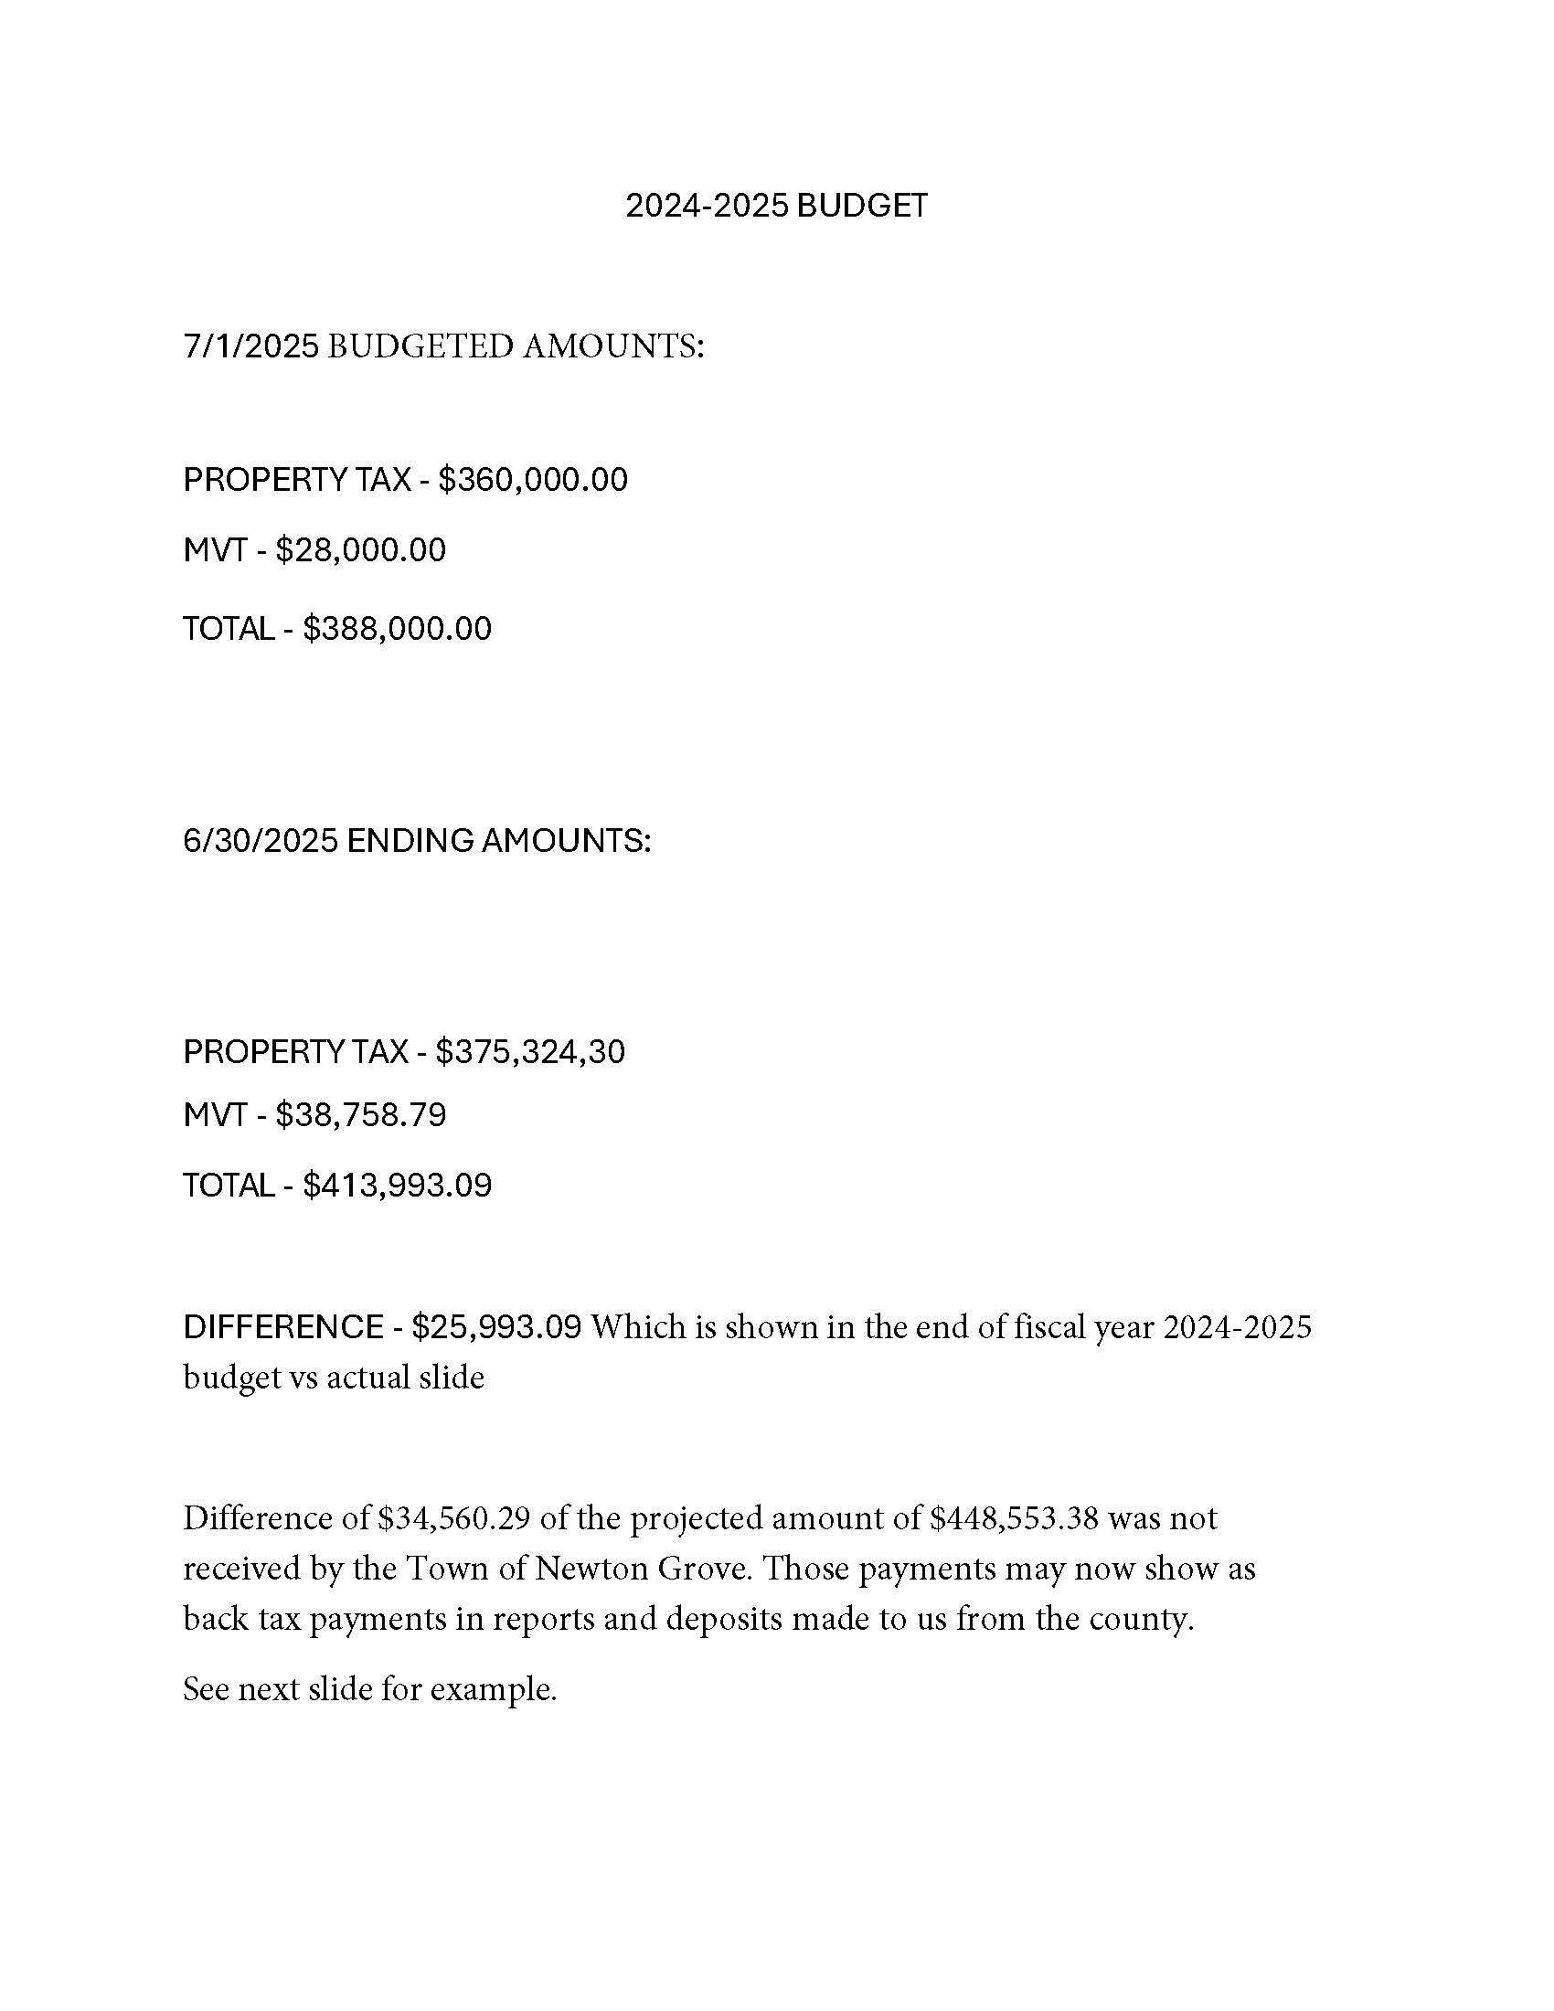

Slide 43
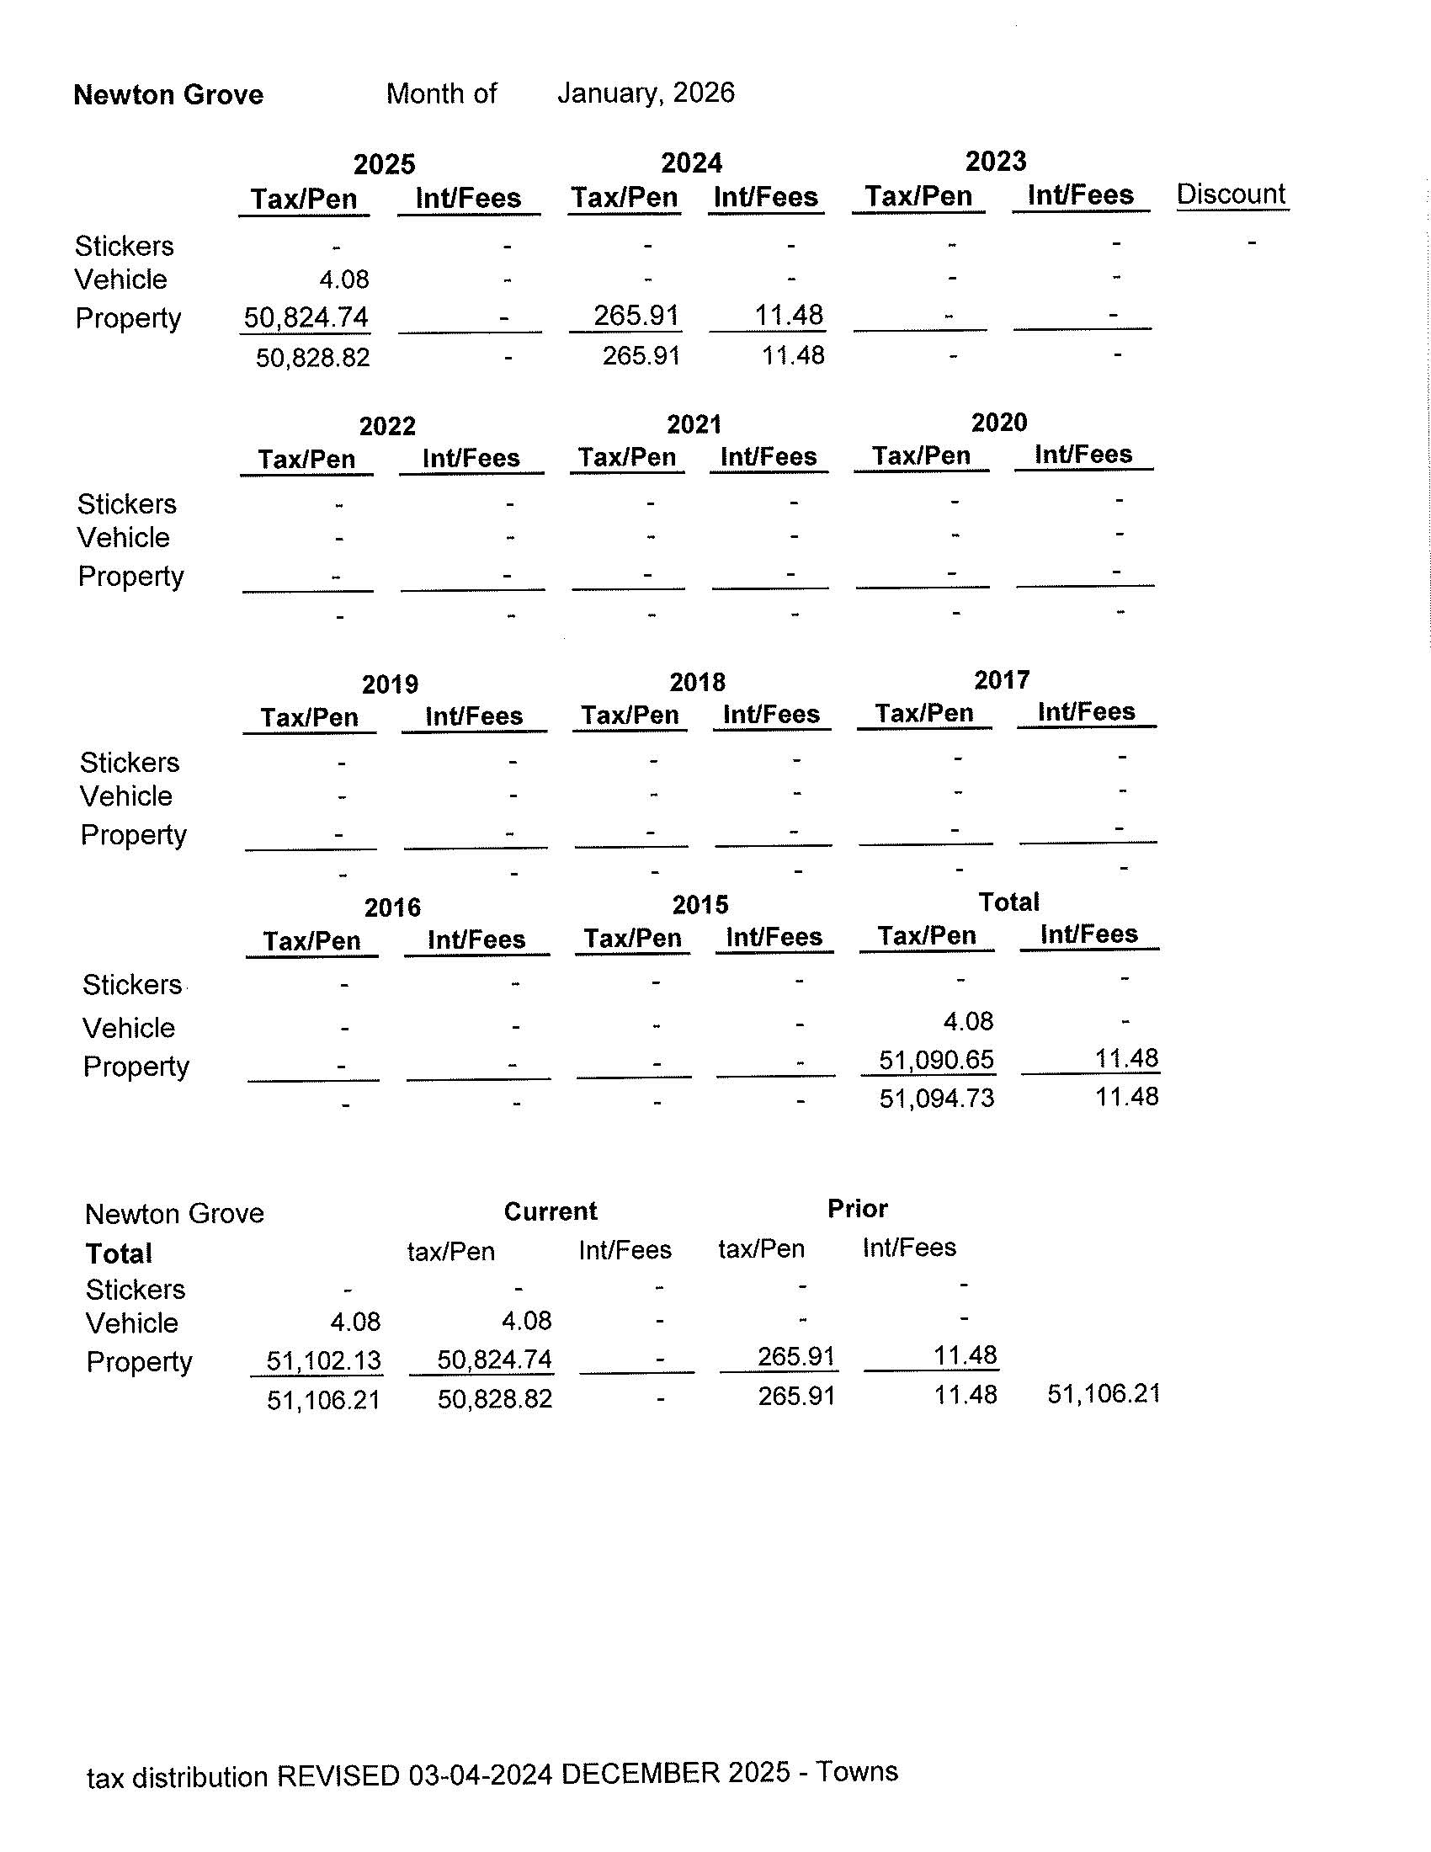
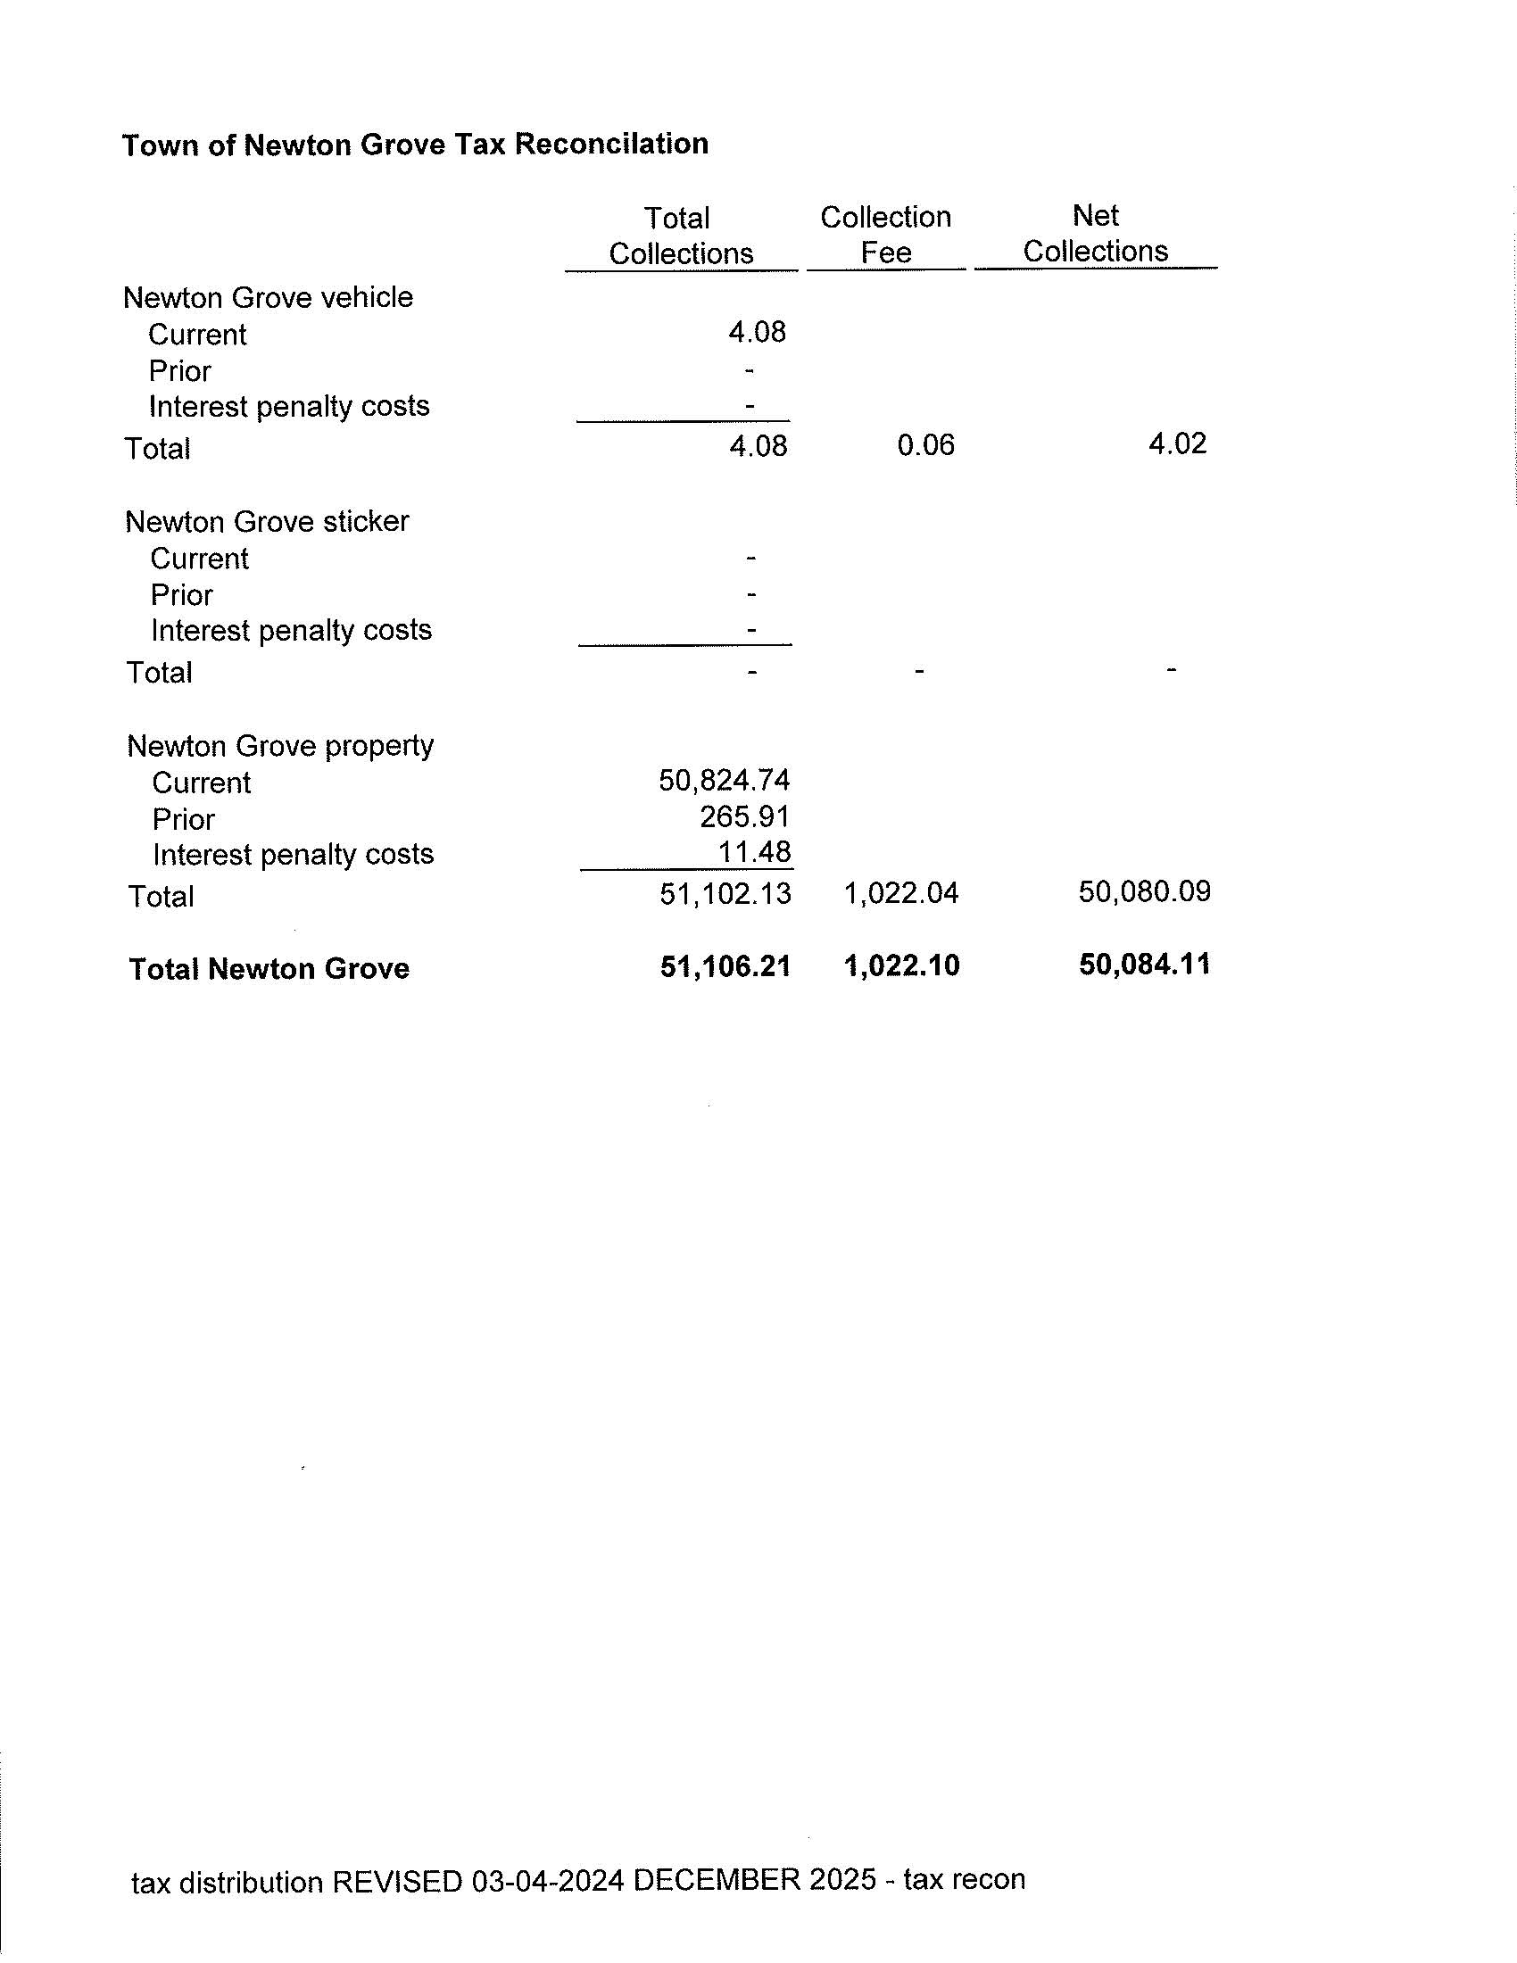

Slide 44
The next few slides are the actual line items in our current budget.

Slide 45
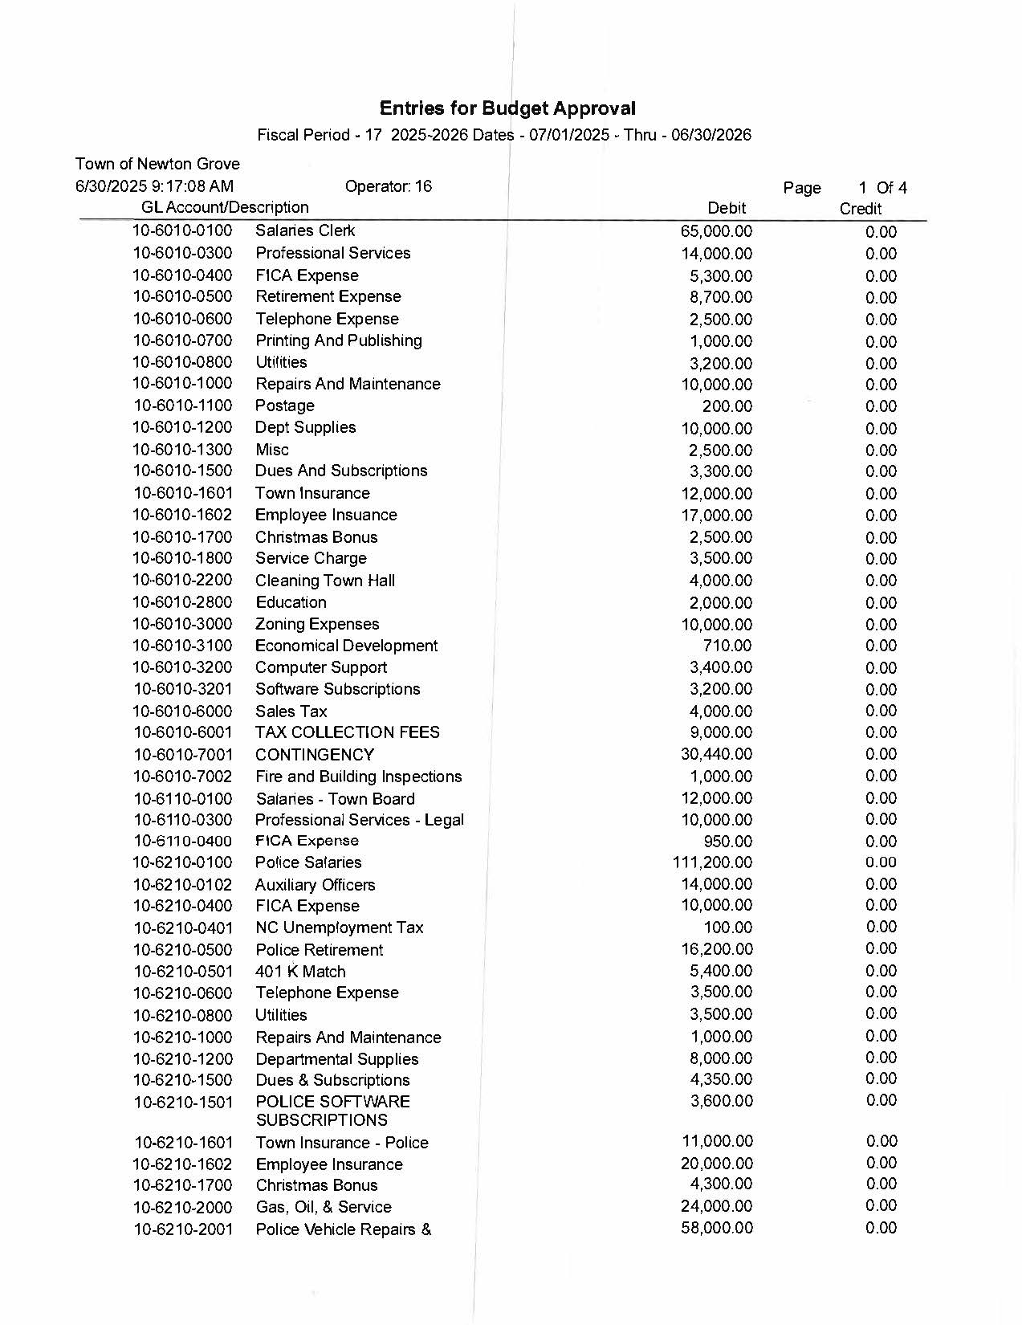

Slide 46
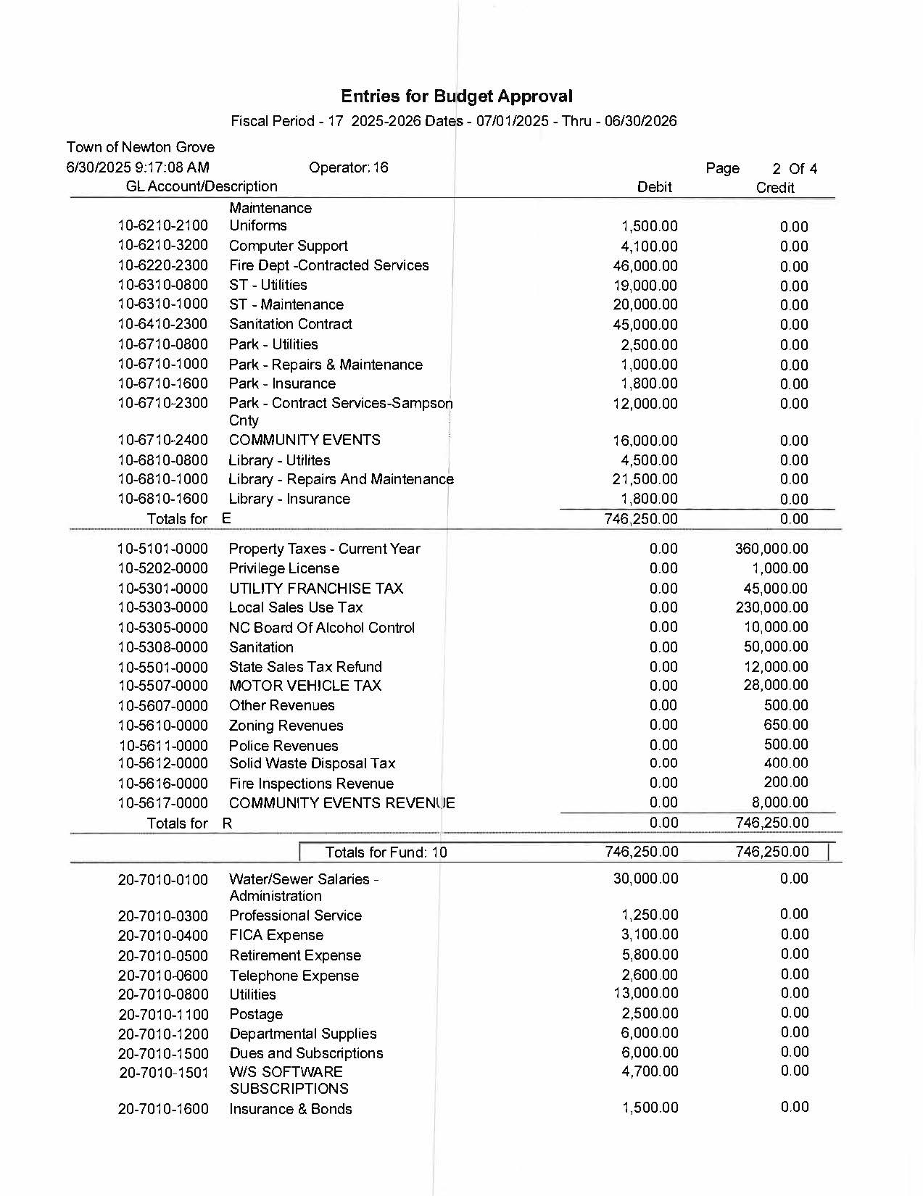

Slide 47
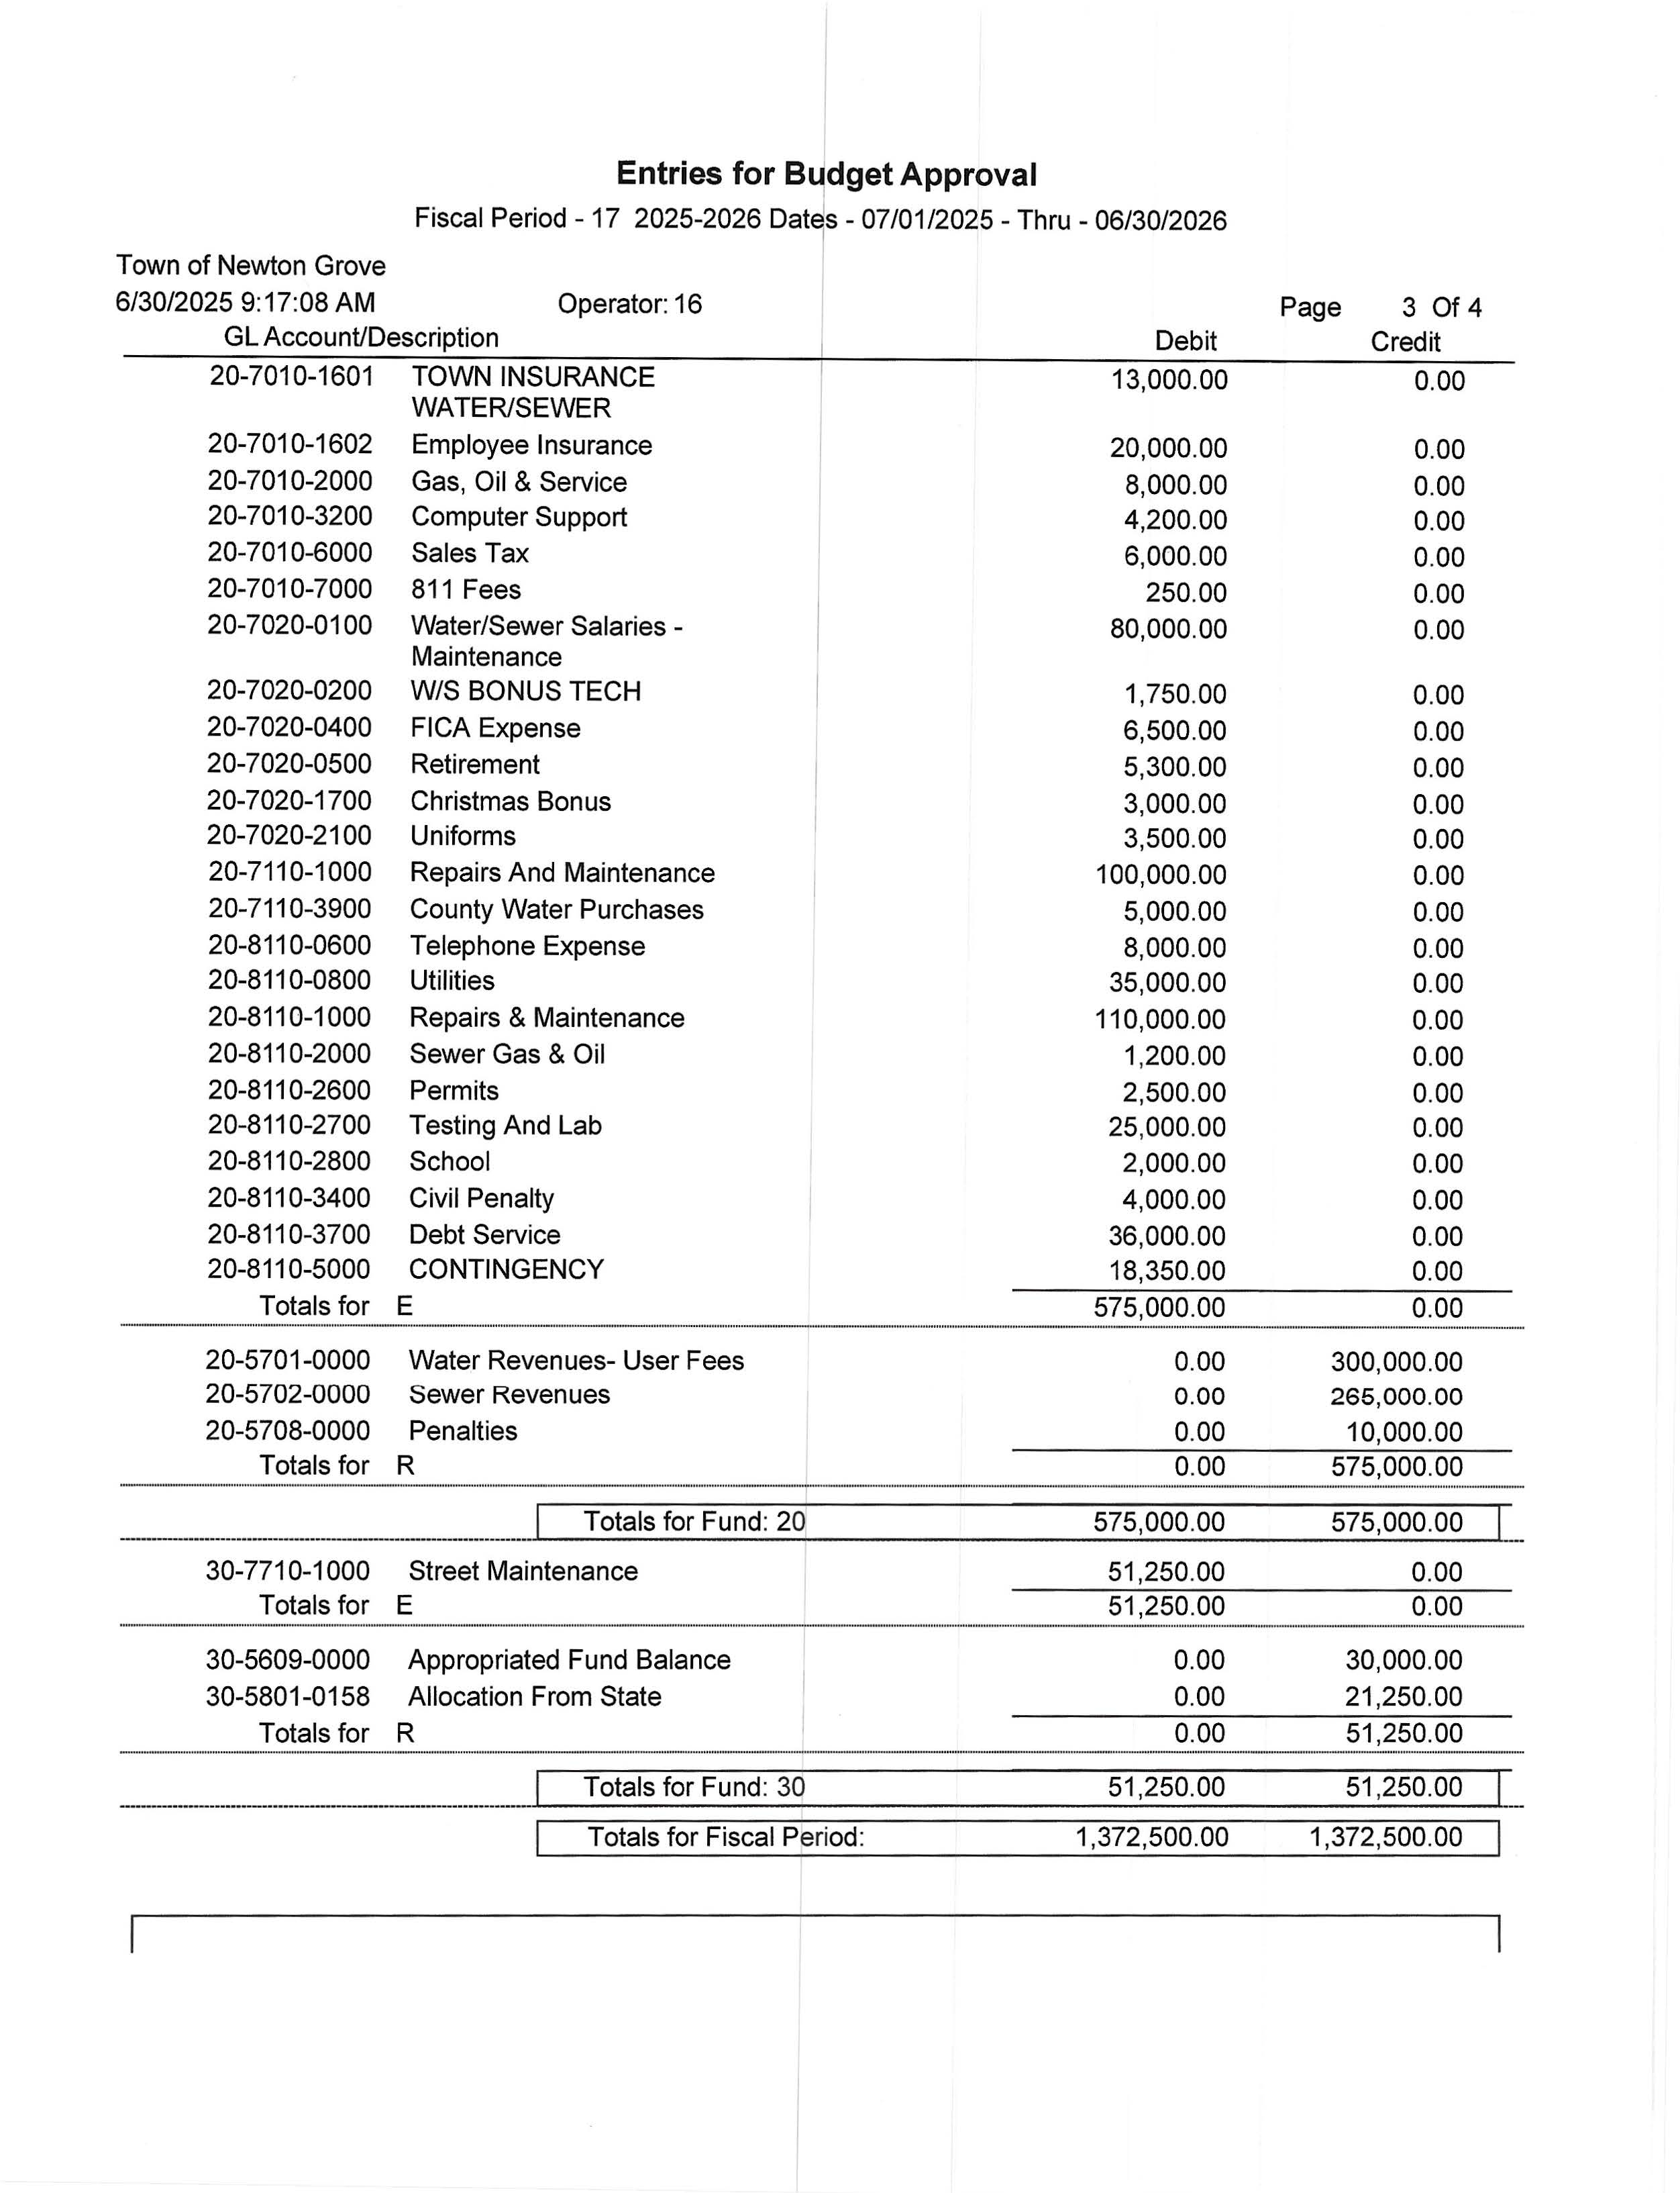

Slide 48
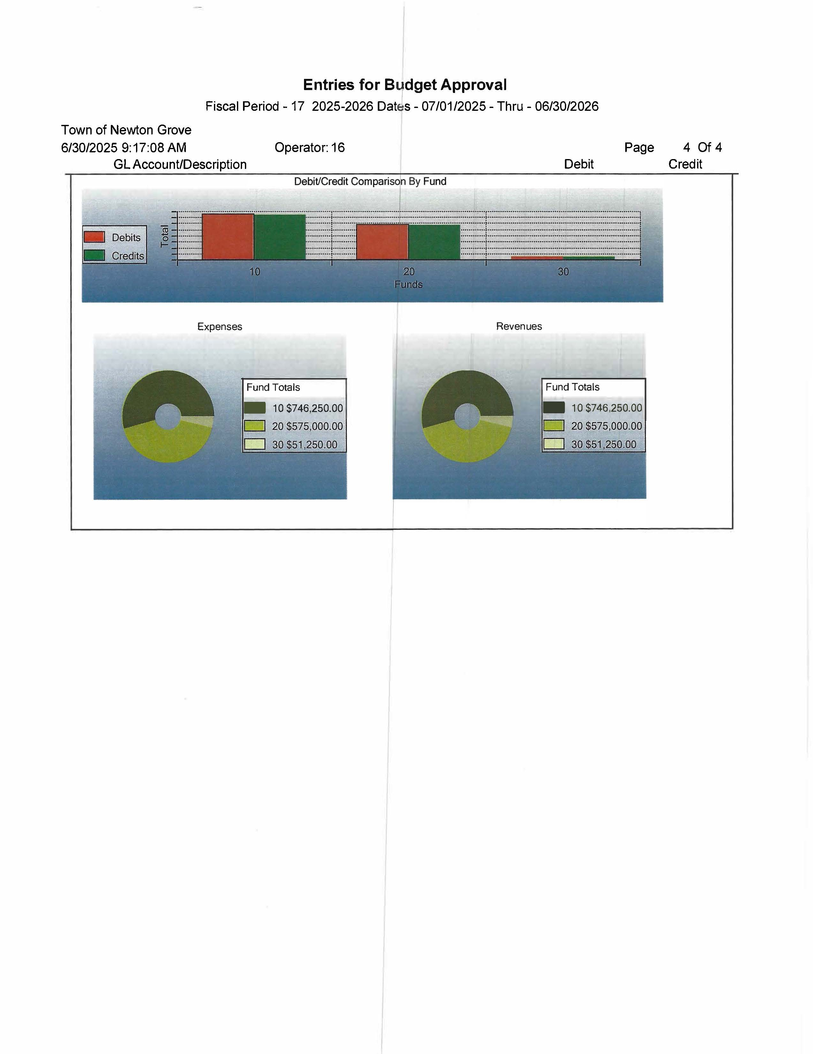

Slide 49
Budgeted Salaries (these are budgeted for but do not have to be paid at that amount. Again, a budget is a proposed way of spending money. Only if you go over the proposed amount, then are you required to do a budget amendment.

Slide 50
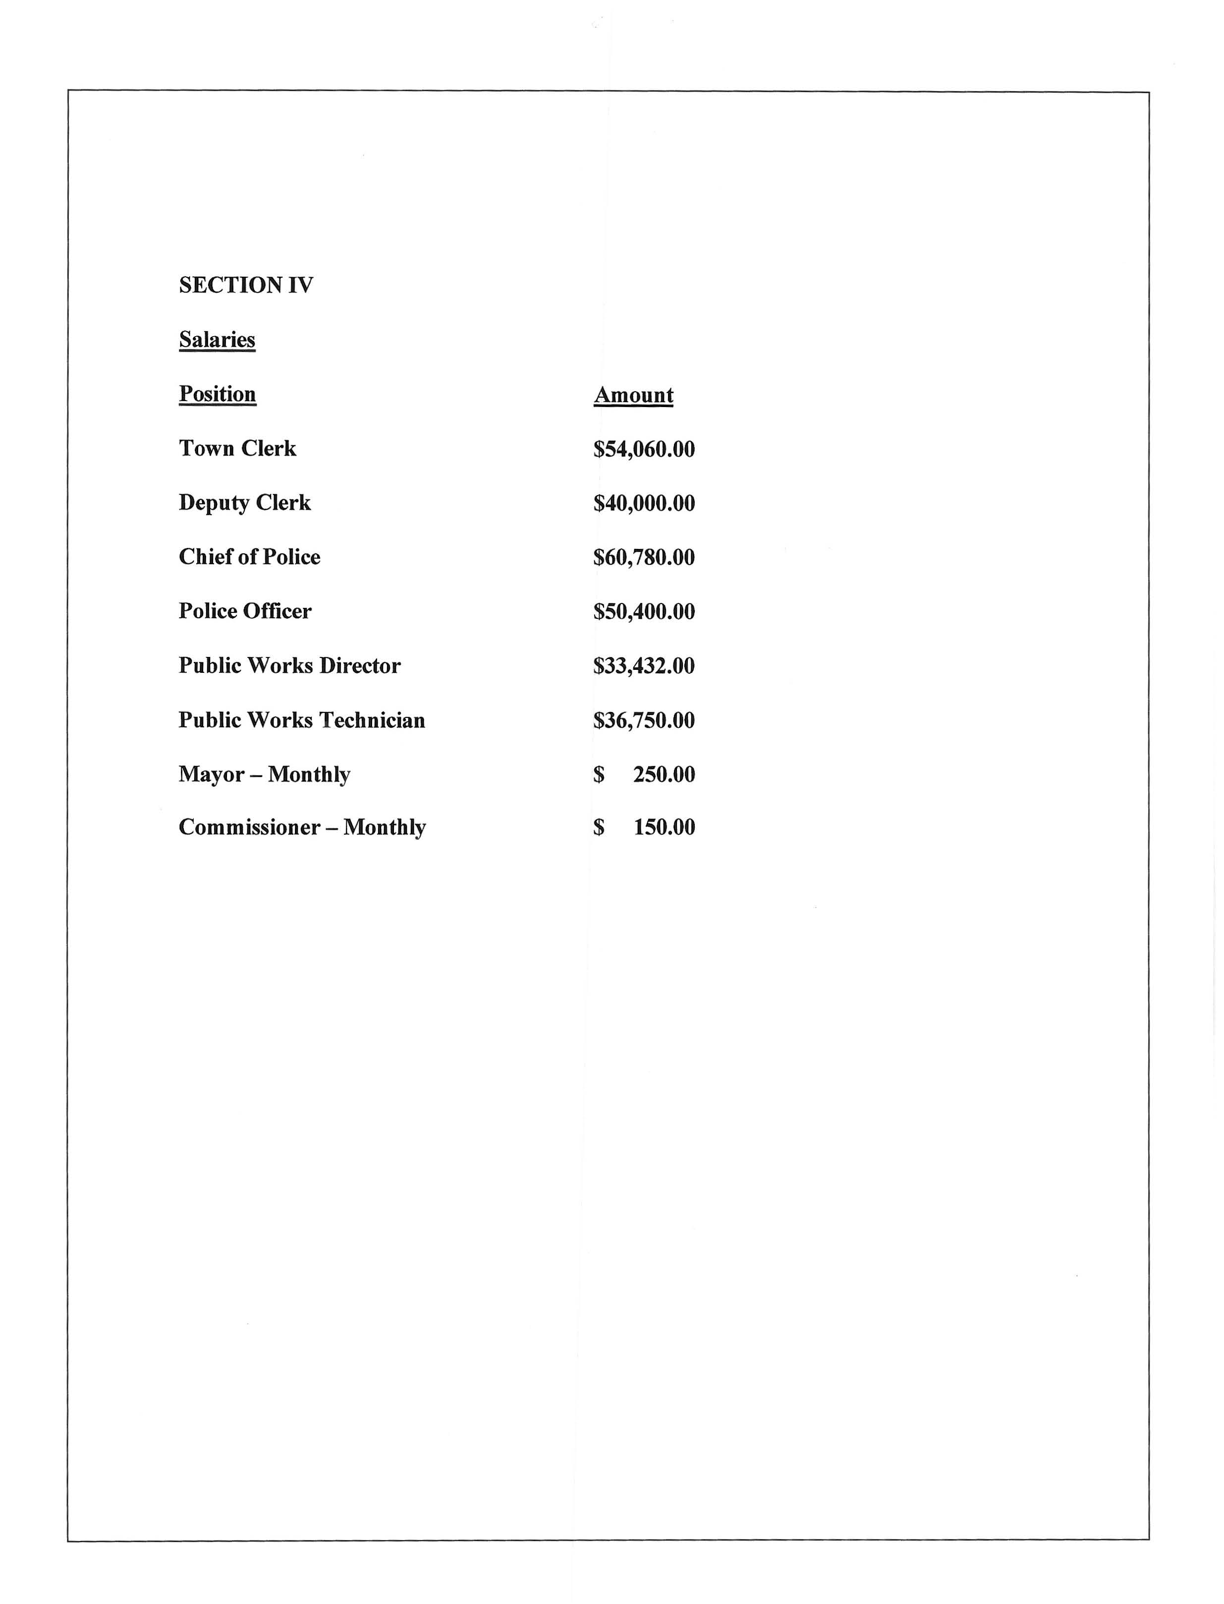
This section was included in the proposed budget packet and also presented at the public hearing.

Slide 51
The Town Clerk salary and ¼ of the Deputy Clerk’s salary is included in the 10-6010-0100 Salaries Clerk line item. ¾’s of the Deputy Clerk’s salary is included in the 20-7010-0100 Water/Sewer Salaries Administration.

Slide 52
Employee Christmas Bonus:
This was not started with this administration. In years past, it was included in the salary line item for each employee and was a check written to each employee in November.

Slide 53
When Clerk Baggett took over, it became mandatory to be paid by direct deposit only. Zero checks were to be made to employees for pay and or bonuses. It was also changed to a line item in the budget for transparency. This bonus is issued in November and is taxed just like pay roll.

Slide 54
Clerk Baggett requested to be removed from the bank account and to not sign checks when sworn in as Town Clerk. This is important for small municipalities with only a few employees. The Mayor and two of our Commissioners are on the bank account and sign our checks.

Slide 55
Public Comment.
In North Carolina, municipal governments must offer at least one monthly public comment period at regular meetings, requiring citizens to sign up (in-person or sometimes online), state their name/address, and speak for a limited time (often 3 mins) on non-agenda topics, following rules for decorum, while governments don't debate or act during this time, but may direct staff to follow-up.

Slide 56
Key Rules & Limitations:
Time limits: typically 3 minutes (ours is 5)
Topic Restrictions: Usually for topics not on the agenda or for public hearings; often excludes personnel, property, or attorney-client privilege matters.
No Debate/Action.
Decorum: No personal attacks, obscene language, or disruptive behavior.
These rules are for and are followed by all NC Municiplities.

Slide 57
This is read before Public Comment at every one of our board meetings:
The public is always welcomed and encouraged to attend monthly board meetings. We are extremely happy to have you come and speak. Please remember public comment is limited to 5 minutes and a timer will be set. If you go over the allotted time, you will be asked to have a seat. Also, please understand that the Board members, the Mayor, nor the Town Attorney are permitted to answer any questions during public comment. The appropriate Commissioner or Mayor will make an appointment to discuss and/or the Clerk will include the answers at the next board meeting in her Clerk Comments.

Slide 58
Zoning:
Unfortunately, this is a no-win job. As Zoning Administrator, it is Clerk Baggett’s responsibility to enforce. People don’t like it, but there are rules and ordinances that you must follow if you live in a city or town limit. Zoning wasn’t really enforced until Clerk Baggett was hired and was told that this was one main issue that needed to be addressed and changed.

Slide 59
Some of you in this room have had zoning offenses, your friends have had zoning offenses, and some of you come and complain to us about things in Town that are not in compliance. You can’t expect us to only make some comply and not others.

Slide 60
The next part of this presentation is about budgeting and the Unit Assistance List.

Slide 61
Thursday, June 10, 2021 Clerk Monk and Mayor Jackson were informed that the Town of Newton Grove was added to the Unit Assistance List (UAL)

Slide 62
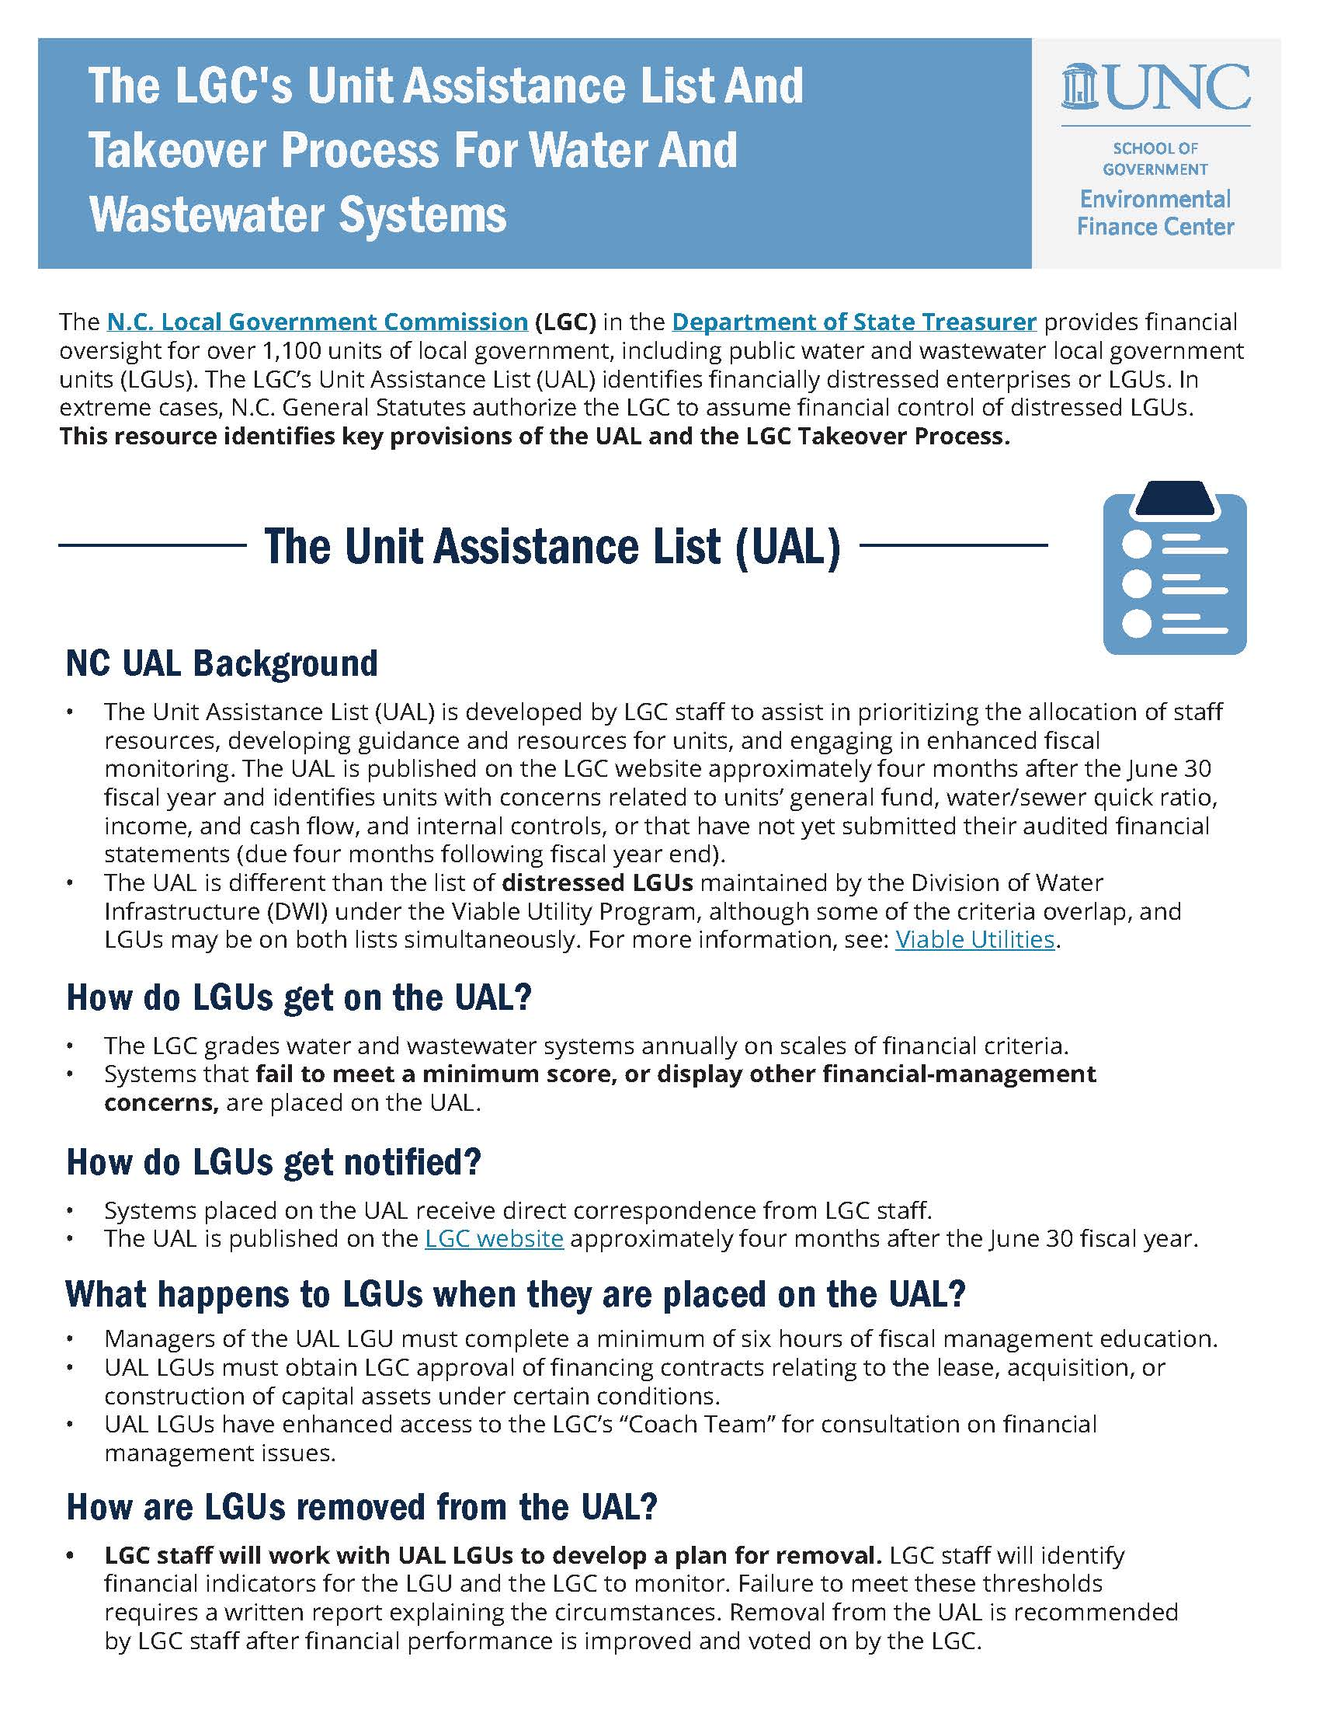
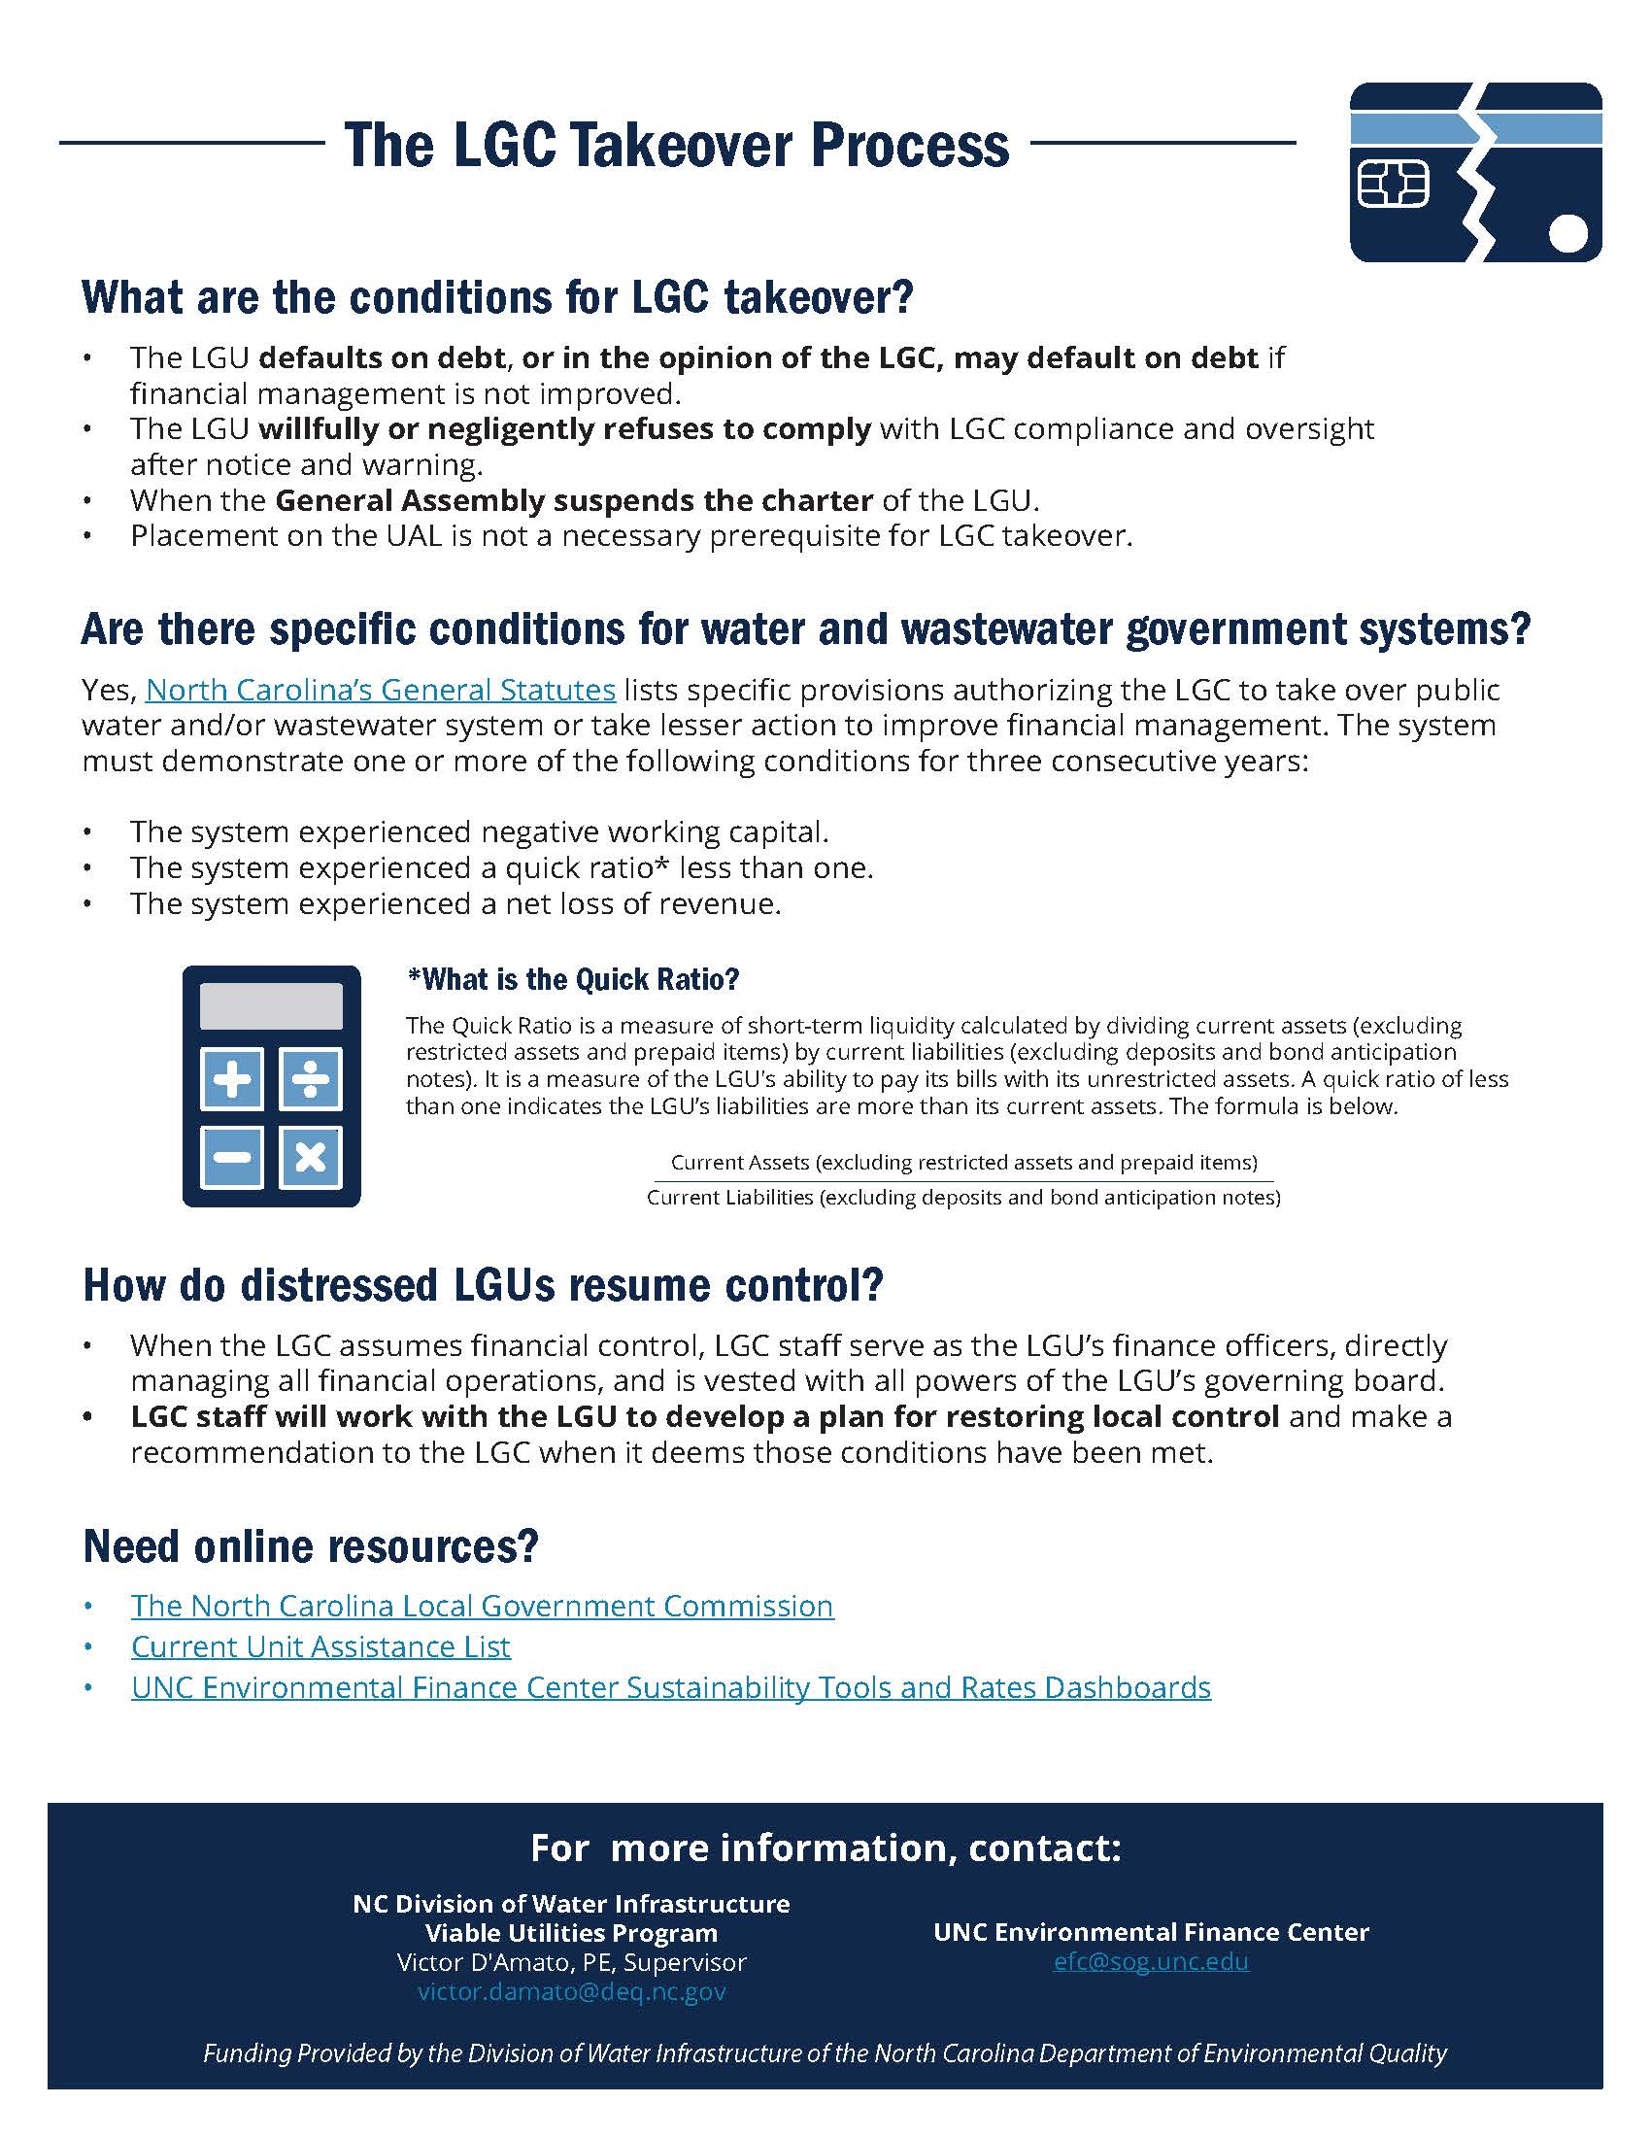

Slide 63
Why was the Town placed on this list:
After a forensic audit by Danna Layne,CPA from Nunn, Brashear, & Uzzell, and an internal audit by Clerk Baggett, the following was found:

Slide 64
1. People were not being made to pay water bills.
2. People were not being made to pay taxes.
3. The water/sewer rates were not updated in the billing system each year after approved by the board.

Slide 65
4. Clerk Baggett rode the trash route with GFL. Customers were not being charged correctly for trash.
5. Clerk Baggett found that many in town were not being charged water/sewer consumption.

Slide 66
North Carolina Rural Water Association was notified to conduct a rate study to help the Town work towards being removed from the UAL list.

Slide 67
The water/sewer rates were raised after the study due to recommendations from the NCRWA and the LGC. This was one step in coming into compliance and one step closer to getting off of the UAL list.

Slide 68
Clerk Baggett and this administration inherited this.

Slide 69
Clerk Baggett was required to complete 6hrs of fiscal management education, required to send budget vs actual reports quarterly to the LGC, and also have budgets approved by the LGC.

Slide 70
Finally at the end of 2024, the Town of Newton Grove was removed from this list.
If we had not made the changes needed and had not been removed from this list, the state of North Carolina would have taken over. And your right to be here tonight to voice your concerns and opinions would not even be allowed. There would be no board, no mayor, and their staff would run the town. The state would set the tax rate and the w/s rates.

Slide 71
This is why Clerk Baggett budgets based on previous revenues. We don’t budget off of projected revenue.
Money that comes in that is more than budgeted is shown at any time in the budget vs actual report.

Slide 72
Everything here is public knowledge. If you want to see a report, just ask. But, please make sure when asking, that you ask for all that you want. If you ask for a financial report, this is what you will get. I can’t assume that you also want minutes, other items, etc.

Slide 73
Missing Money???????

Slide 74
Appropriated fund balance is “savings”, not revenue.
Appropriated fund balance was being used to make the revenues match the expenses in the budget.

Slide 75
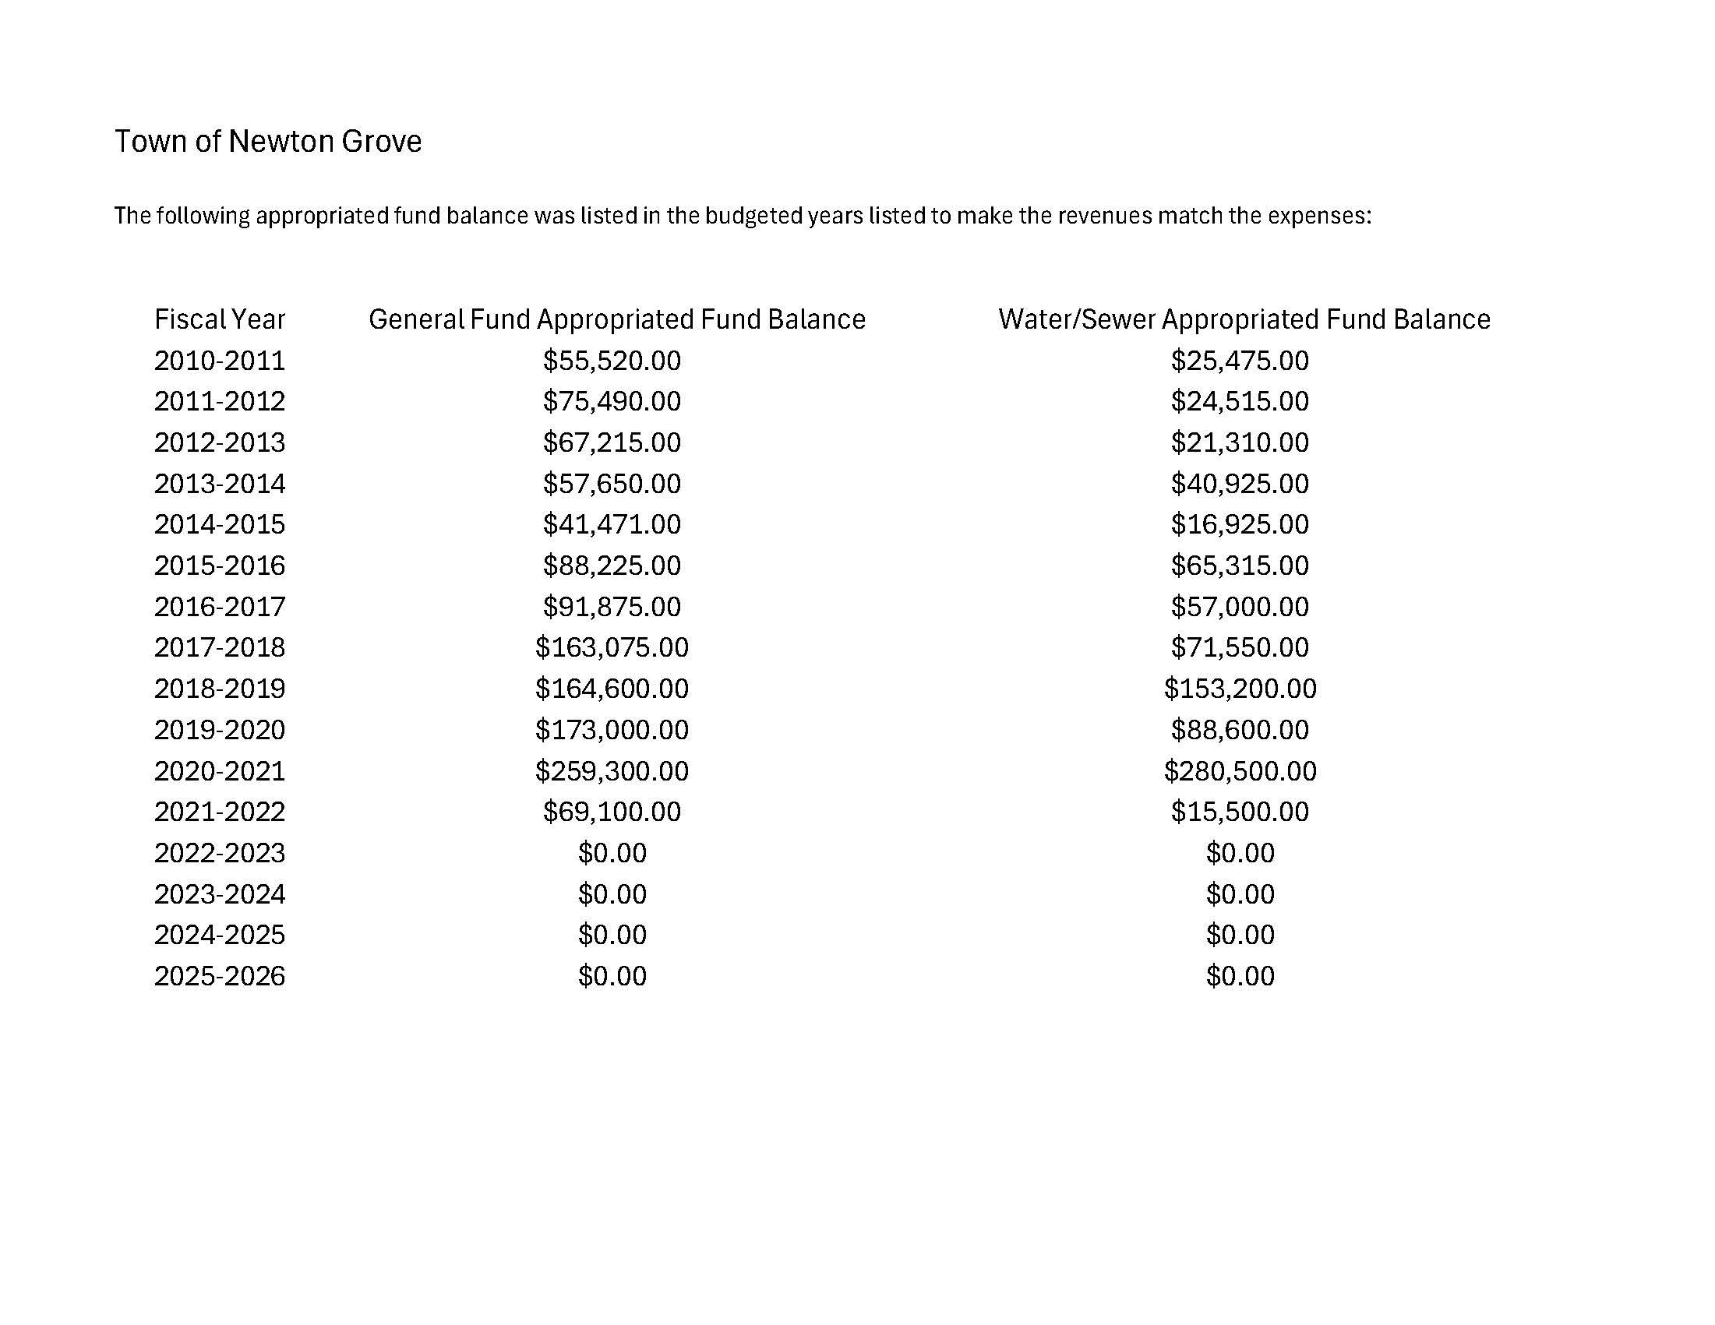

Slide 76
I cannot say how much of it was actually spent during each budget as budget amendment documents were not kept as well as they are now. There is no doubt that the board did budget amendments, we just can’t find the documentation.

Slide 77
There is no blame to be made on anyone. When presenting a budget to the board you show that revenues and expenses equal.

Slide 78
To conclude this presentation, I want to make it very clear that myself, nor the mayor have a vote. I work for the mayor and the commissioners and I do as I am told.

Slide 79
Thank you to everyone that came out tonight to hear this presentation.

Slide 80
If you have any questions please feel free to contact:
Danna Layne, CPA, CFE
Nunn, Brashear, & Uzzell, P.A.
919-778-1000 ext. 228
Beverly Stroud, CPA PLLC
252-902-9537

